Slide 1
Phase 1
Implementation of the Paper’s Model

Slide 2
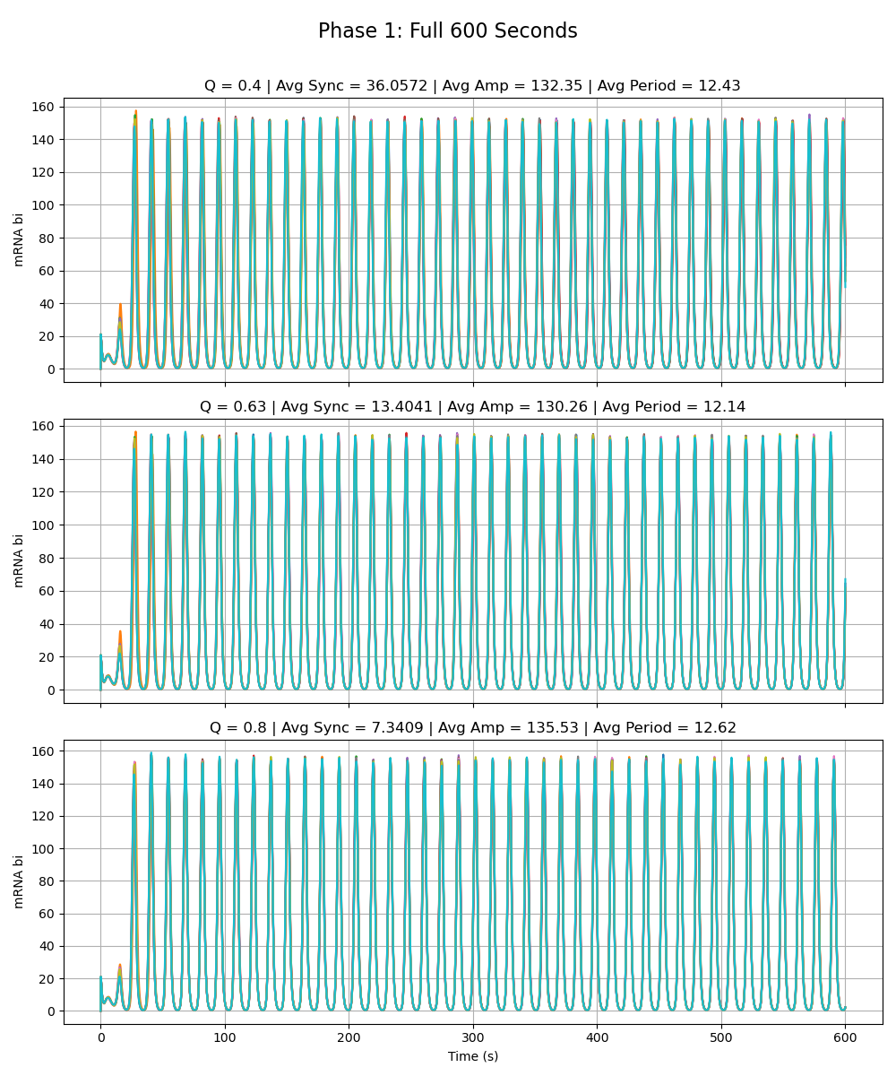
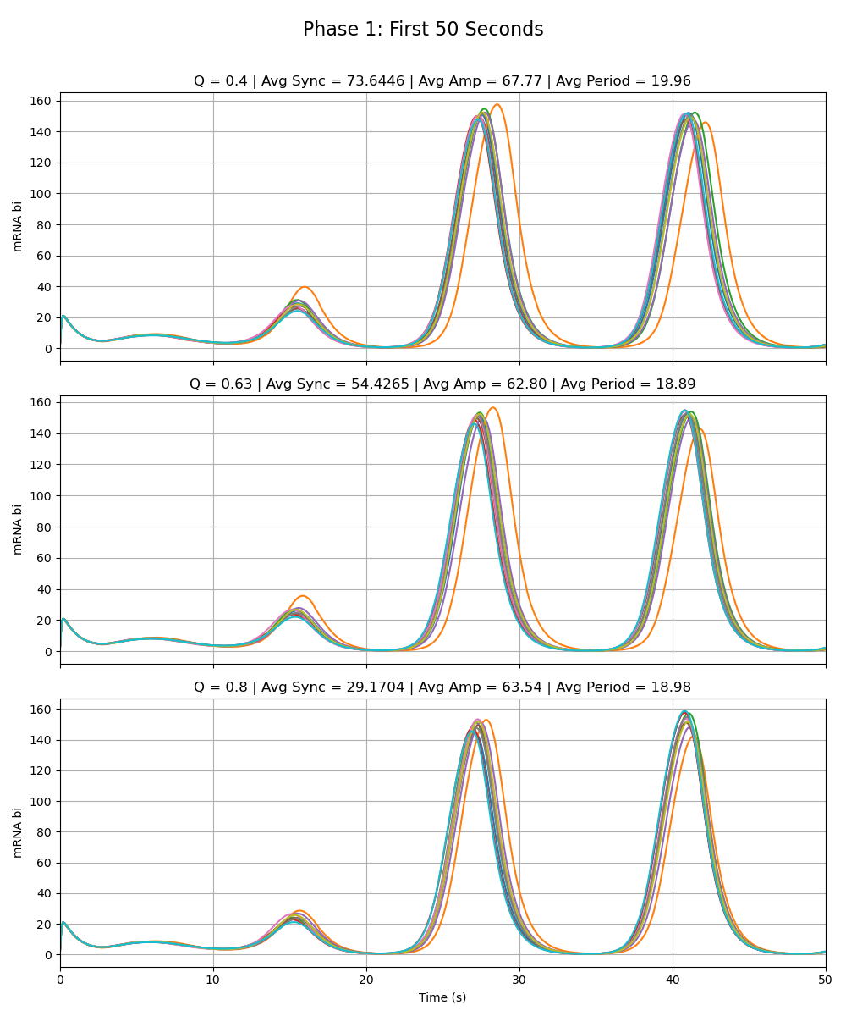
Paper’s Model
Notes:
Phase 1

Slide 3
Phase 2a – Node W
Adriana

Slide 4
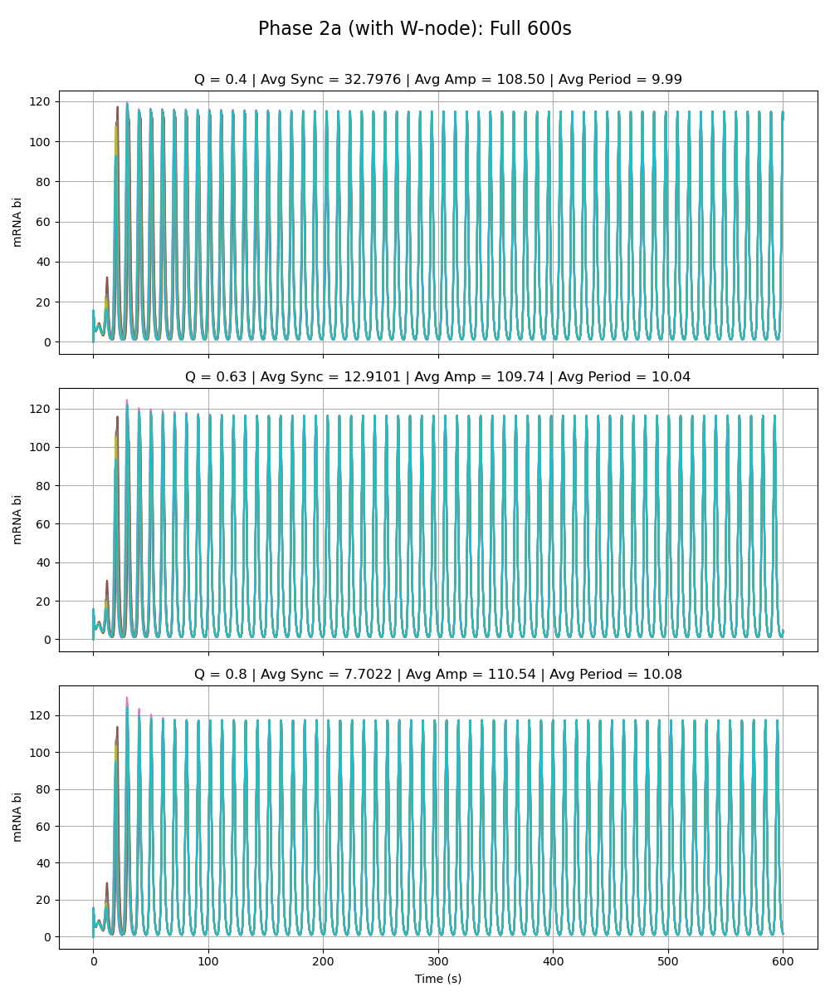
Weak Added Node
Notes:
Phase 2a – added link is very weak (max rate of w transcription is very low 0.01 vs. max rate for the rest as given by paper 216)

Slide 5
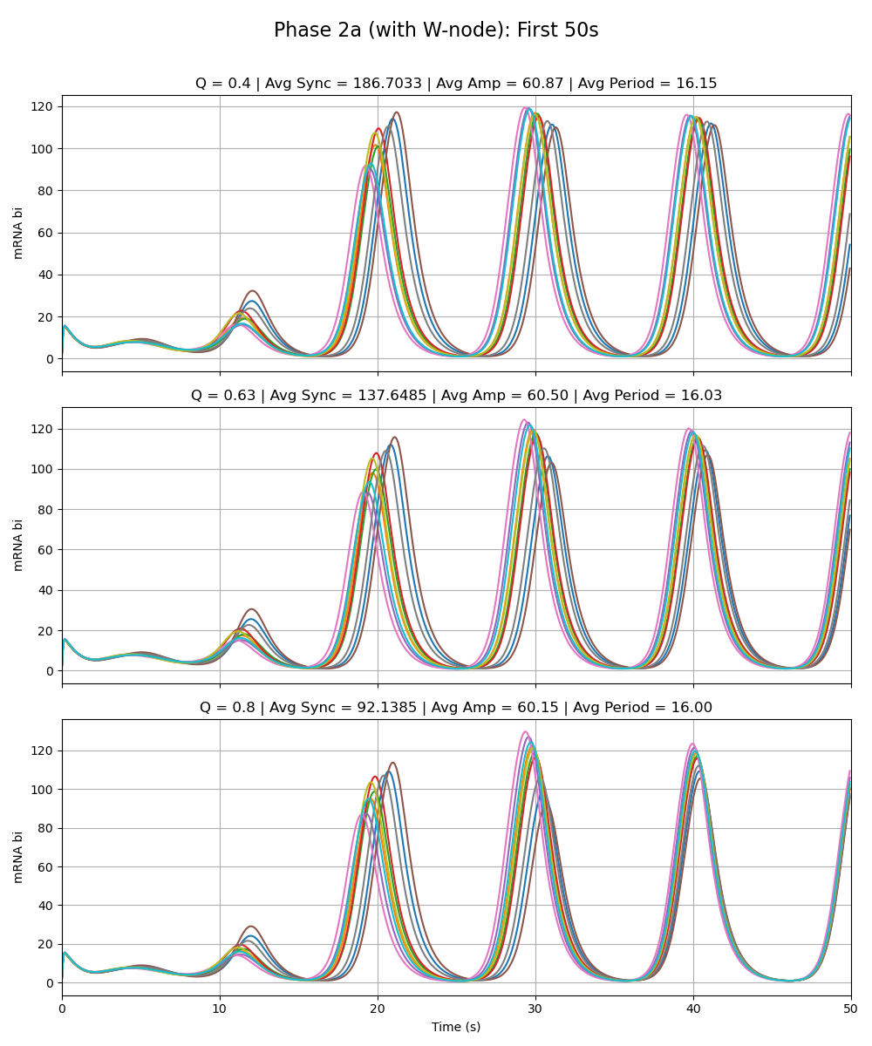
Weak Added Node
Notes:
Phase 2a – added link is very weak (max rate of w transcription is very low 0.01 vs. max rate for the rest as given by paper 216)

Slide 6
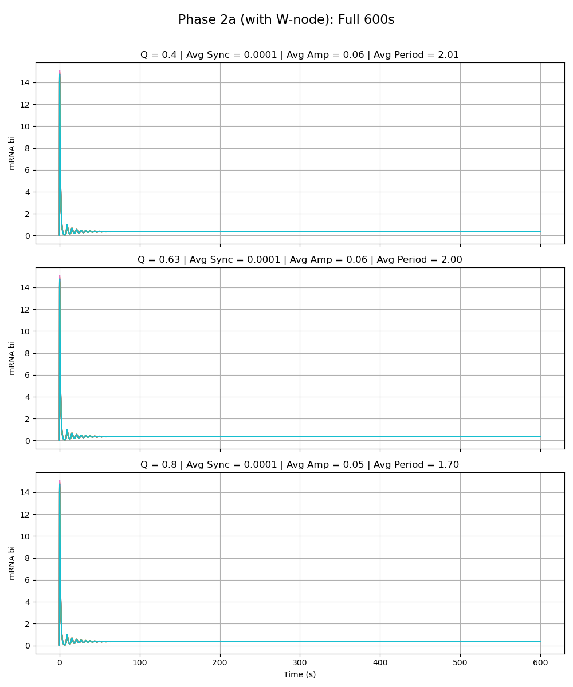
Equal Strength Added Node
Notes:
Phase 2a – added link is same strength as the rest of the circuit (max rate of w transcription is 216 vs. max rate for the rest as given by paper 216)

Slide 7
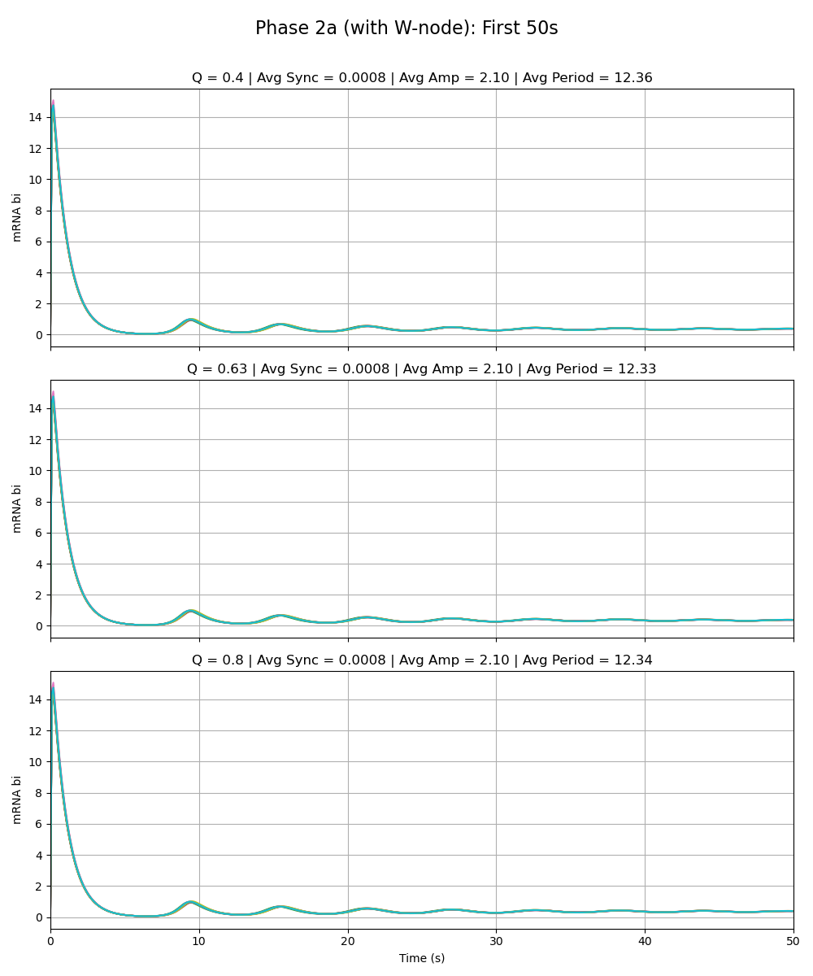
Equal Strength Added Node
Notes:
Phase 2a – added link is same strength as the rest of the circuit (max rate of w transcription is 216 vs. max rate for the rest as given by paper 216)

Slide 8
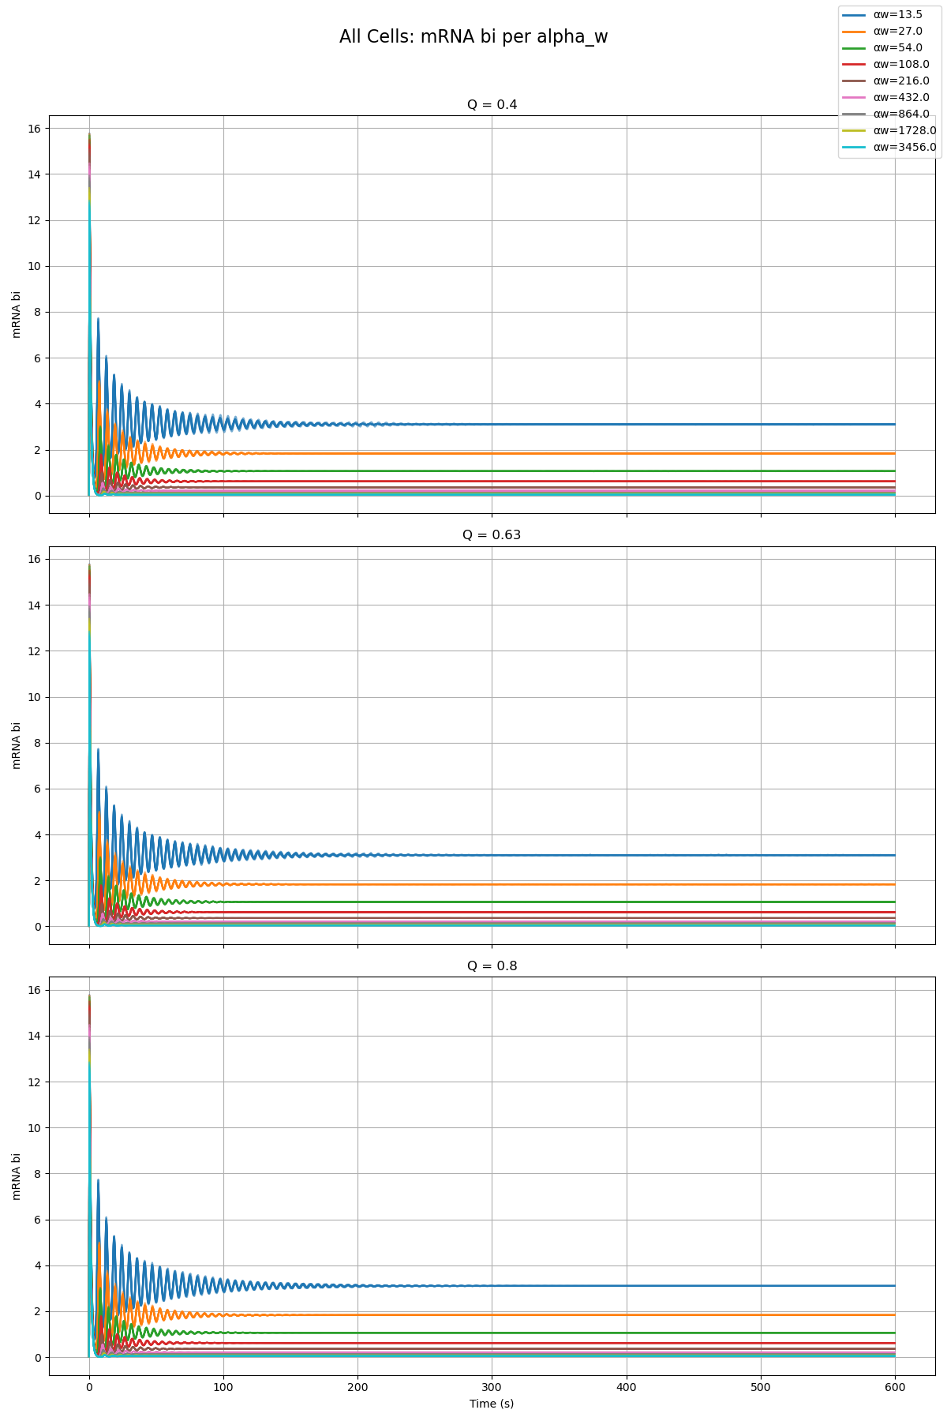
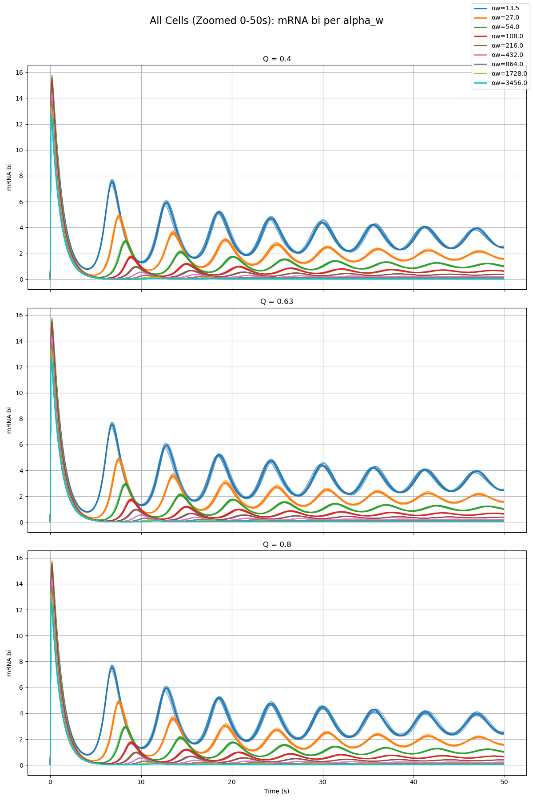
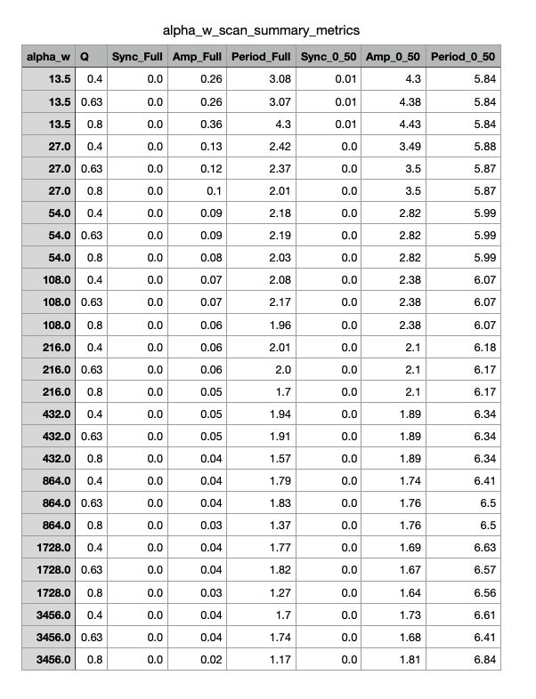
Parameter Scan

Slide 9
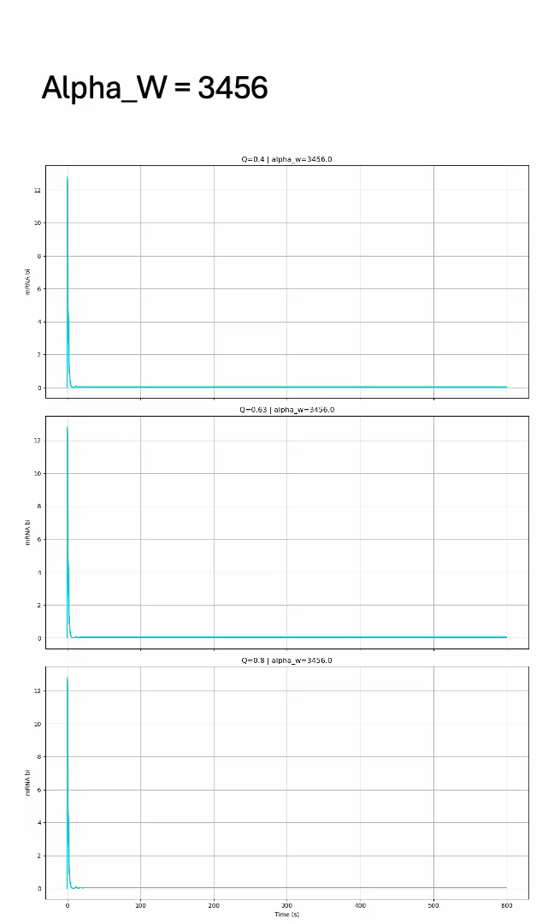
Parameter Scan

Slide 10
Phase 2a – Node X
Sydney

Slide 11
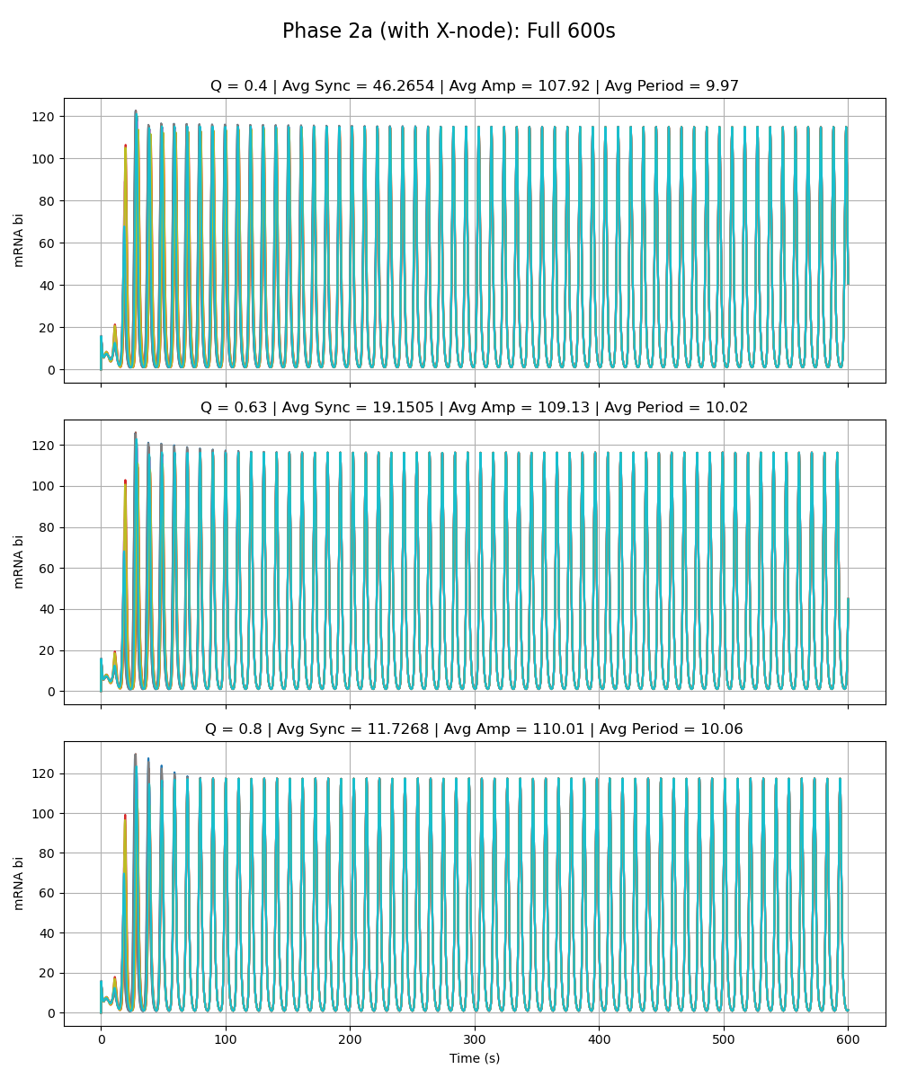
Weak Added Node
Notes:
Phase 2a – added link is very weak (max rate of x transcription is very low 0.01 vs. max rate for the rest as given by paper 216)

Slide 12
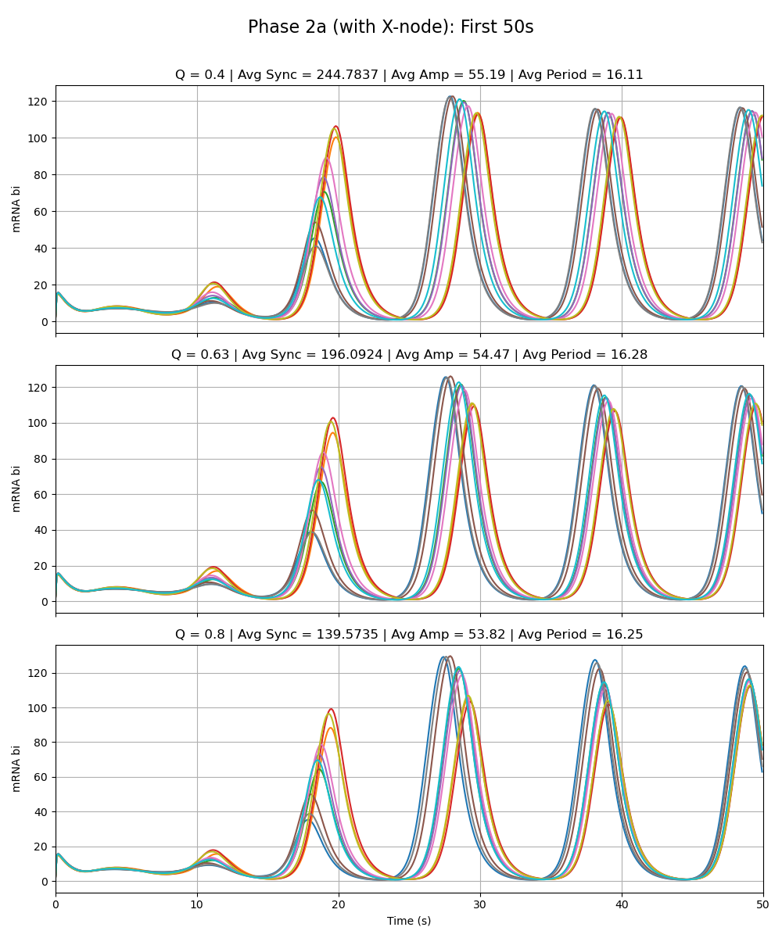
Weak Added Node
Notes:
Phase 2a – added link is very weak (max rate of x transcription is very low 0.01 vs. max rate for the rest as given by paper 216)

Slide 13
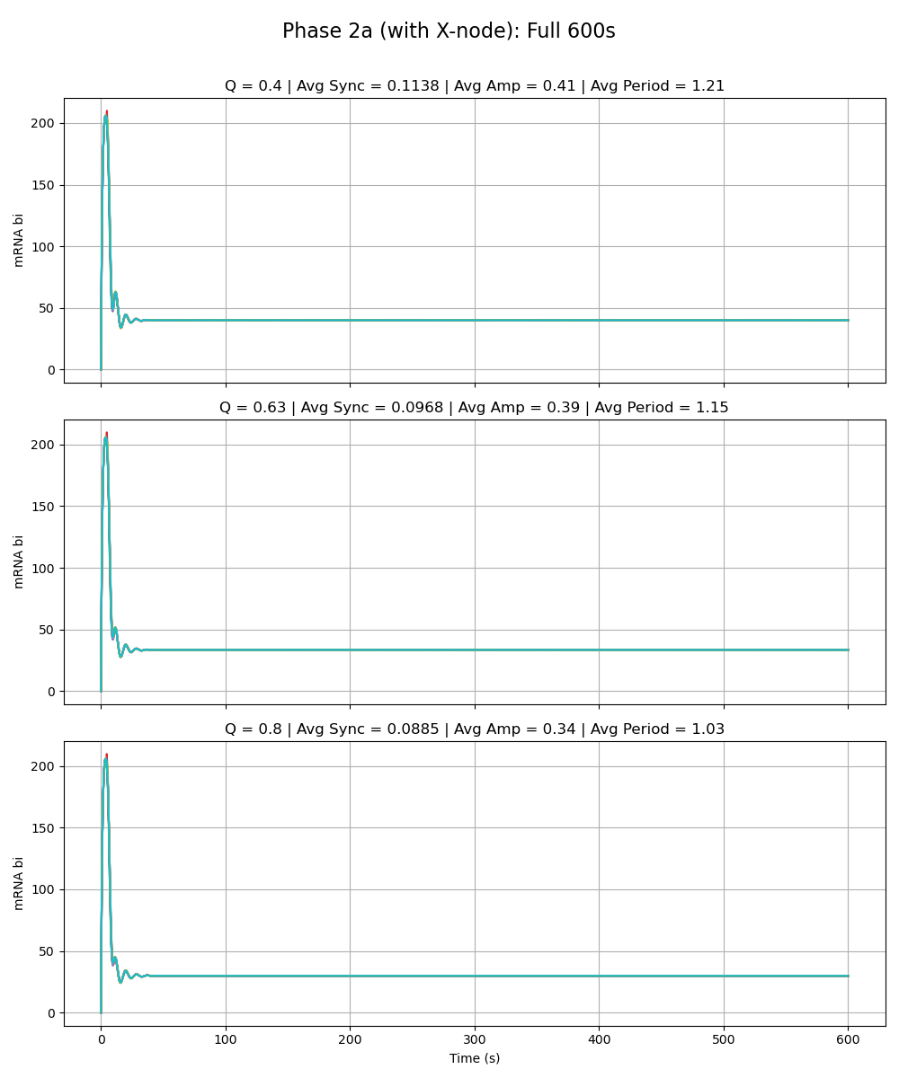
Equal Strength Added Node
Notes:
Phase 2a – added link is same strength as the rest of the circuit (max rate of x transcription is 216 vs. max rate for the rest as given by paper 216)

Slide 14
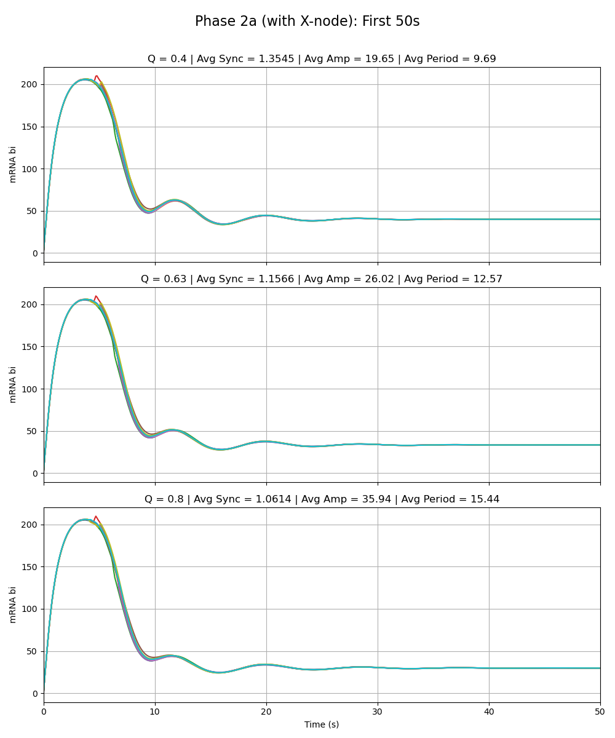
Equal Strength Added Node
Notes:
Phase 2a – added link is same strength as the rest of the circuit (max rate of x transcription is 216 vs. max rate for the rest as given by paper 216)

Slide 15
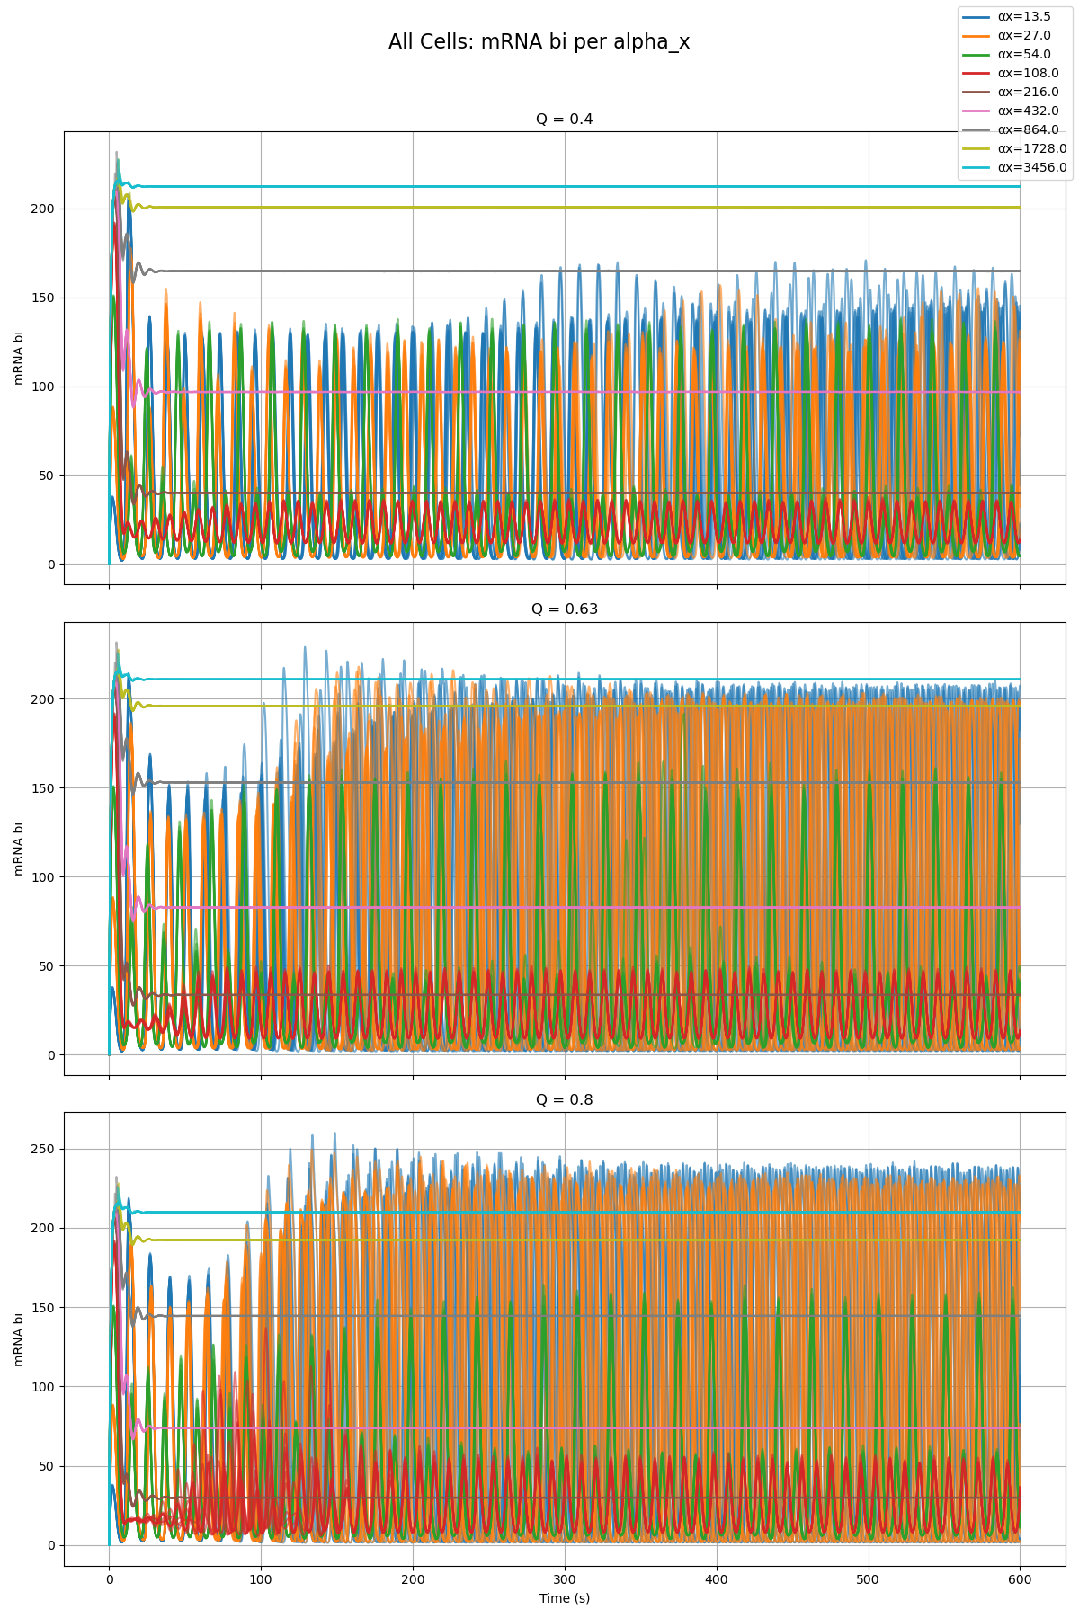
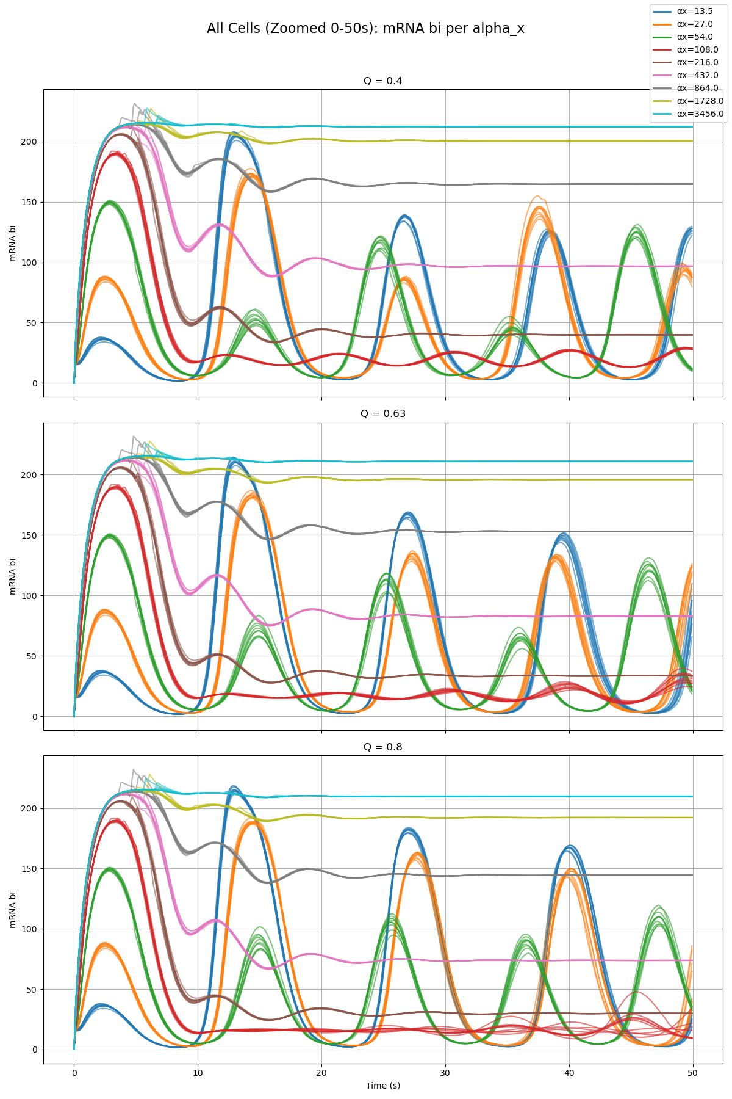
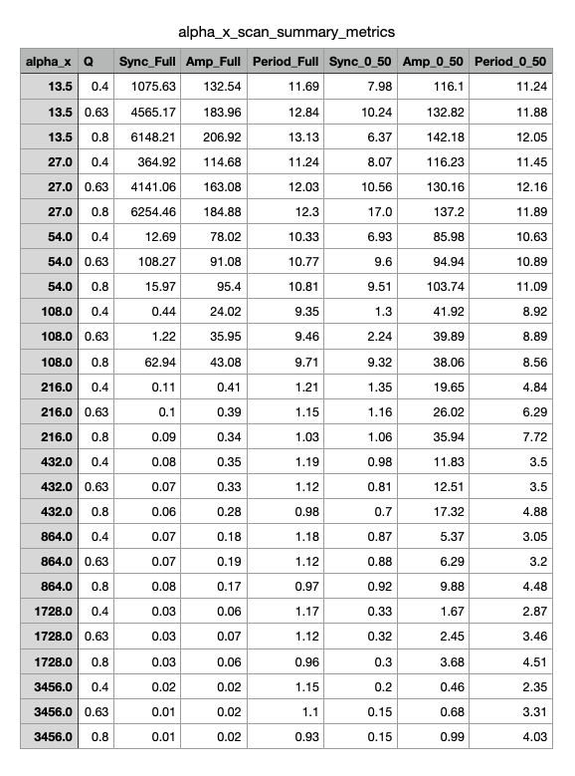
Parameter Scan

Slide 16
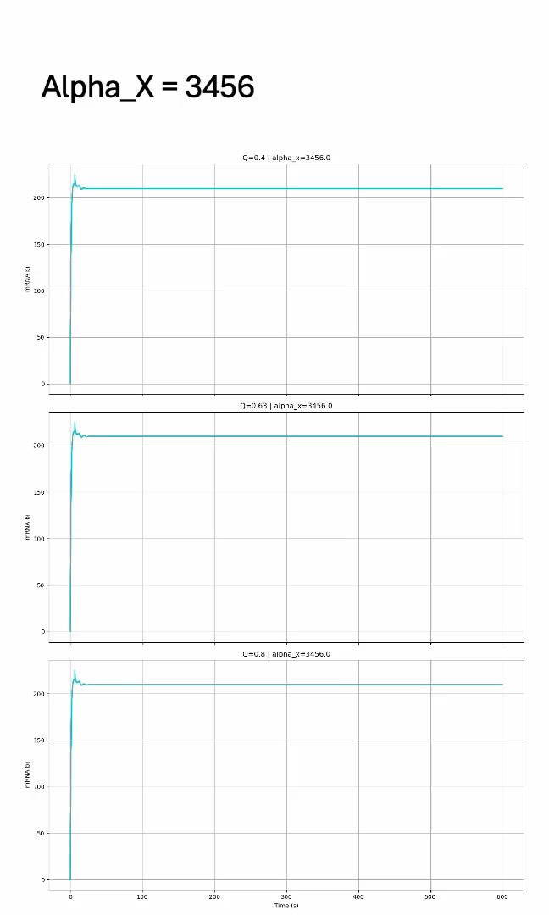
Parameter Scan

Slide 17
Phase 2a – Node Y
Sean

Slide 18

Weak Added Node
Notes:
Phase 2a – added link is very weak (max rate of y transcription is very low 0.01 vs. max rate for the rest as given by paper 216)

Slide 19
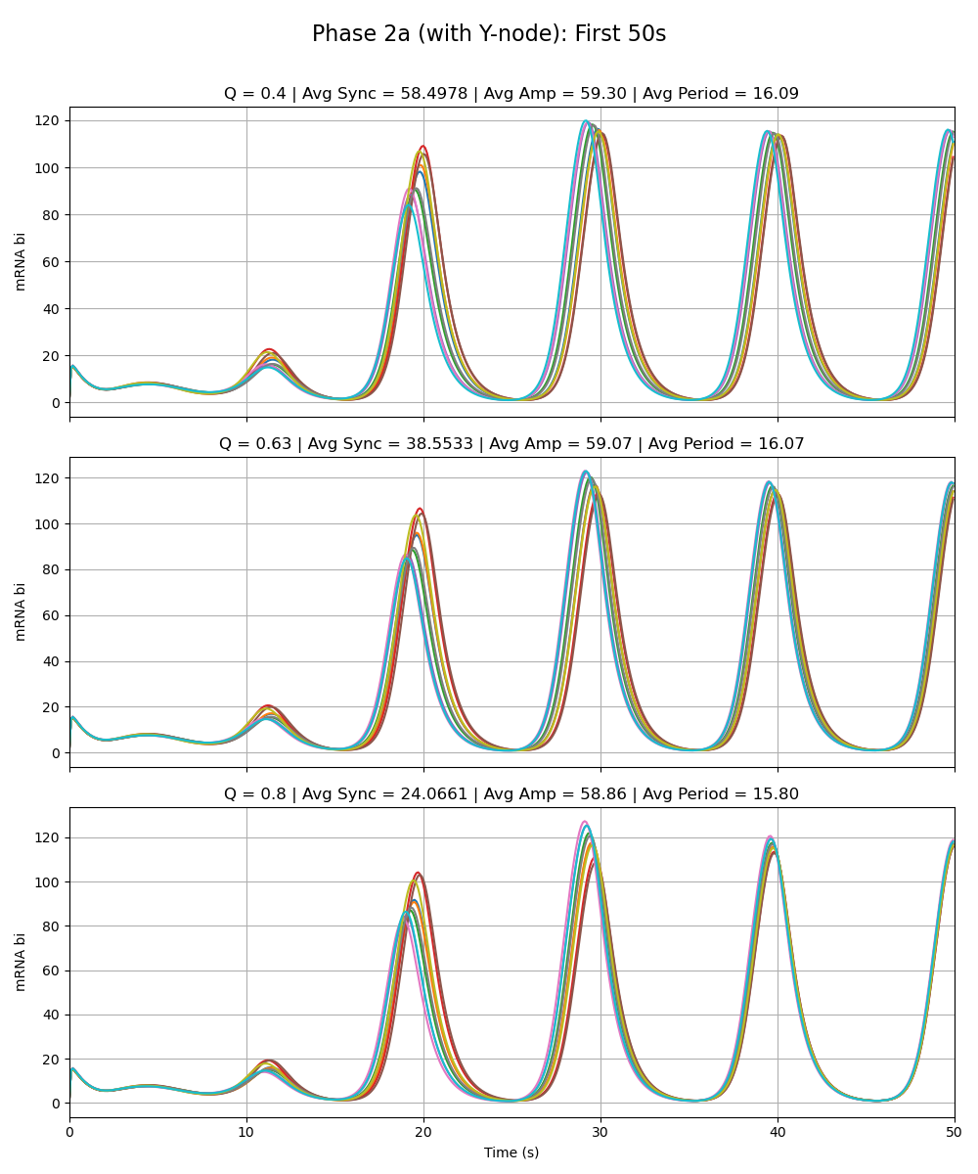
Weak Added Node
Notes:
Phase 2a – added link is very weak (max rate of y transcription is very low 0.01 vs. max rate for the rest as given by paper 216)

Slide 20
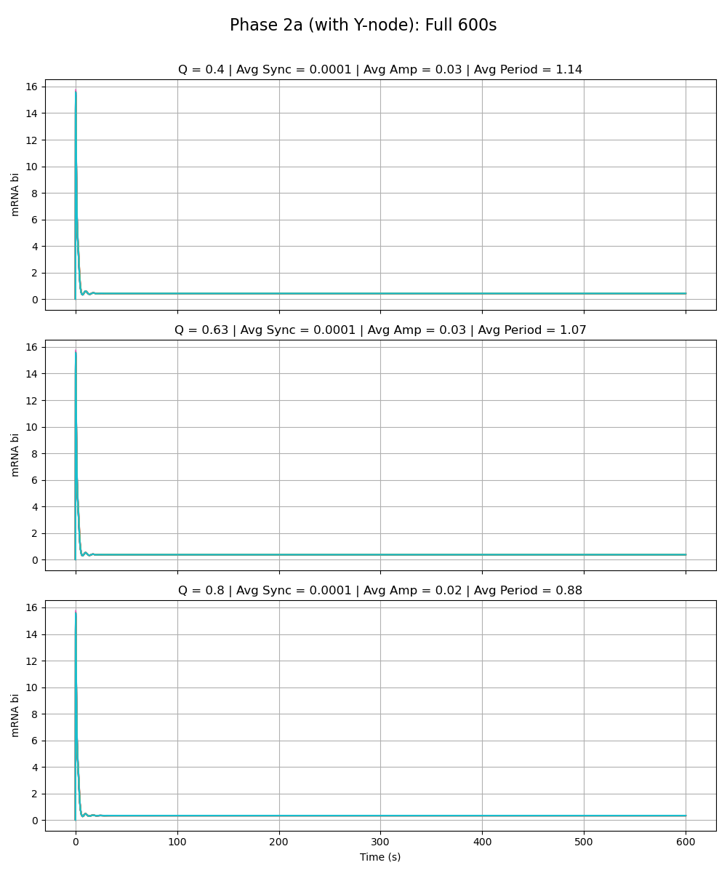
Equal Strength Added Node
Notes:
Phase 2a – added link is same strength as the rest of the circuit (max rate of y transcription is 216 vs. max rate for the rest as given by paper 216)

Slide 21
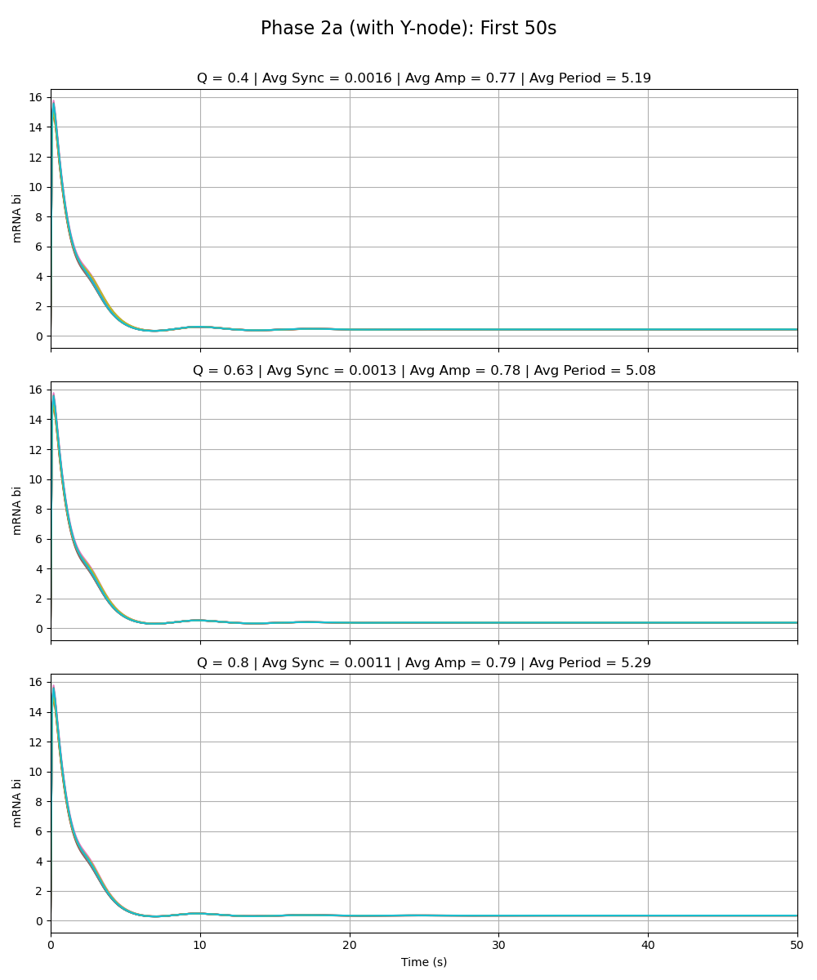
Equal Strength Added Node
Notes:
Phase 2a – added link is same strength as the rest of the circuit (max rate of y transcription is 216 vs. max rate for the rest as given by paper 216)

Slide 22
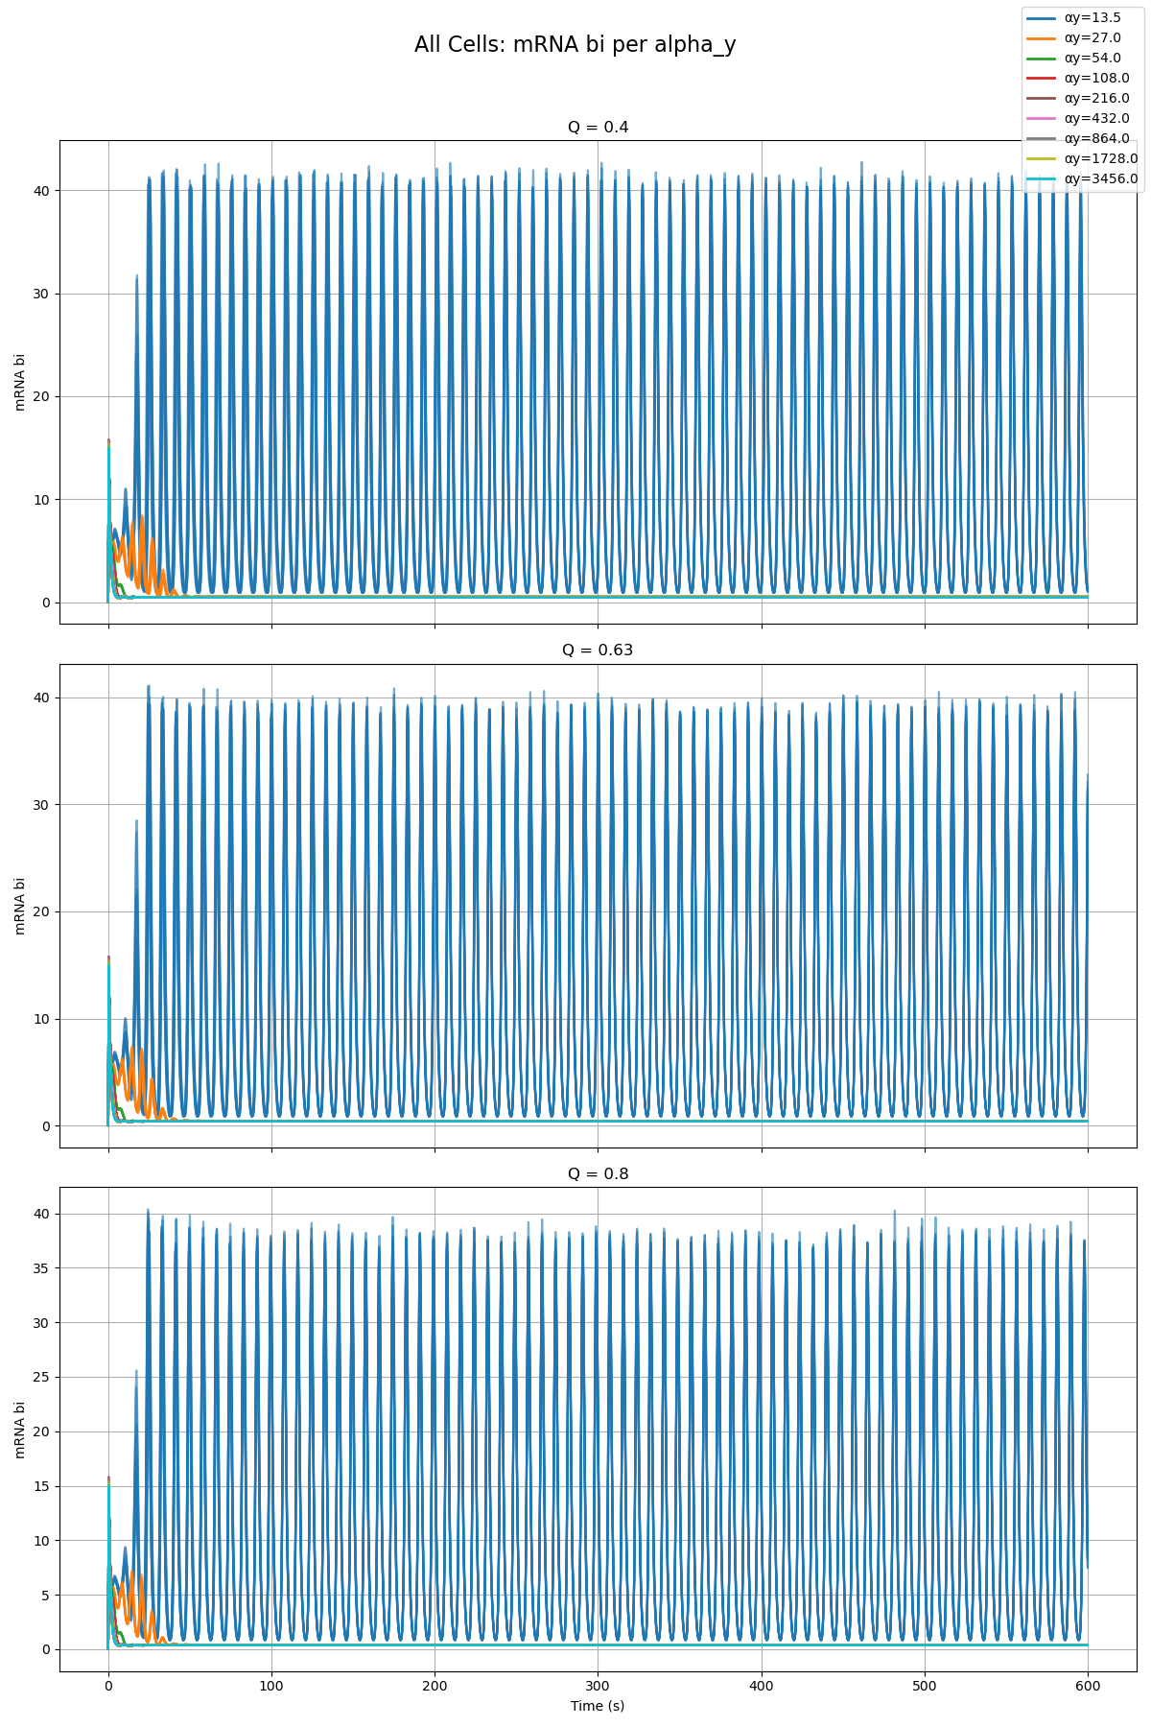
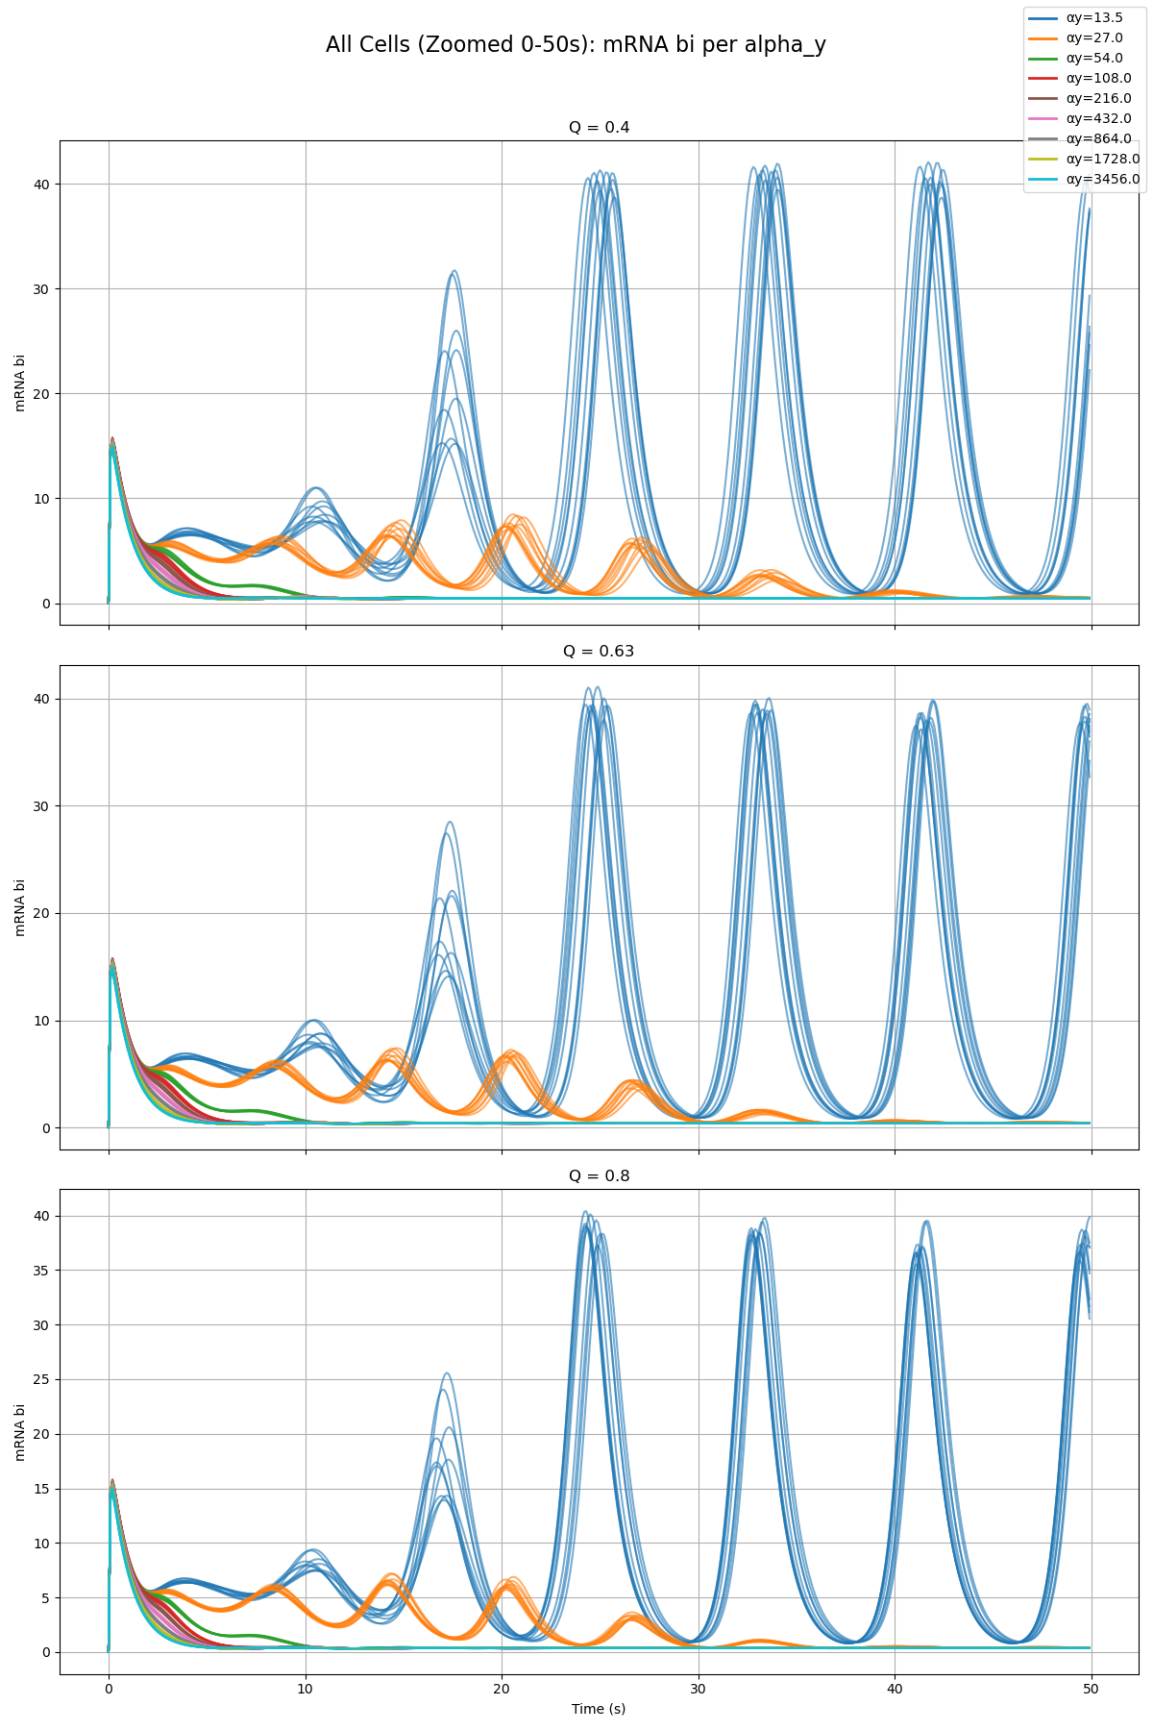
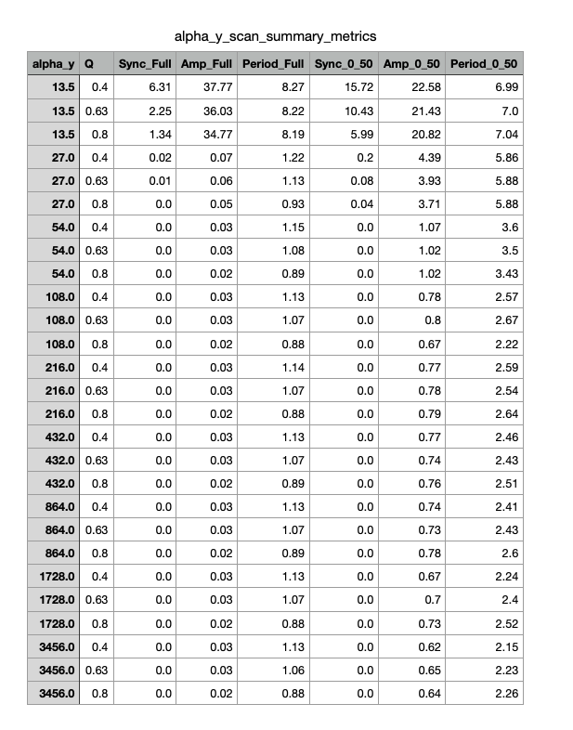
Parameter Scan

Slide 23
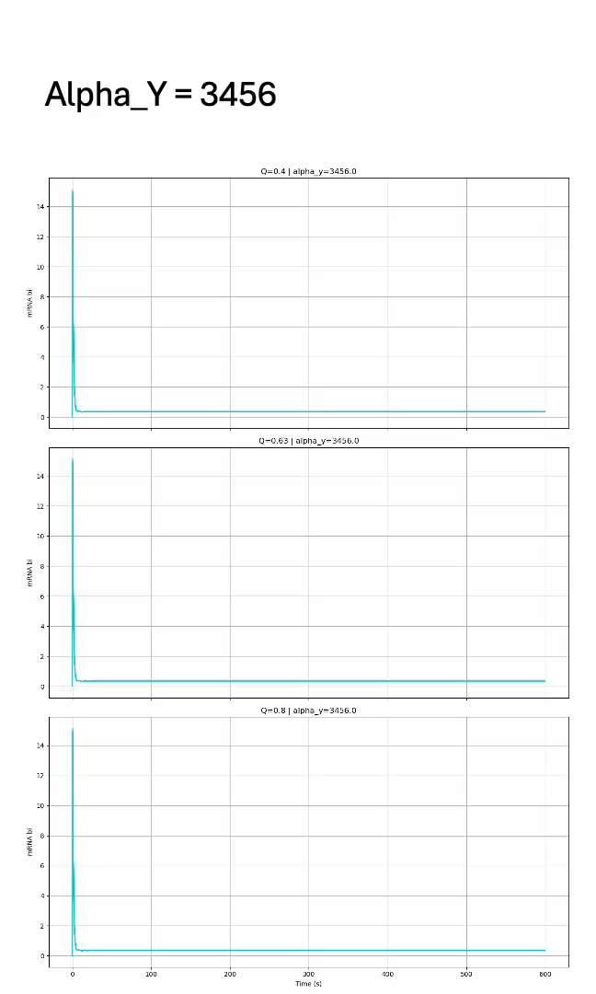
Parameter Scan

Slide 24
Phase 2a – Node Z
Olivia

Slide 25

Weak Added Node
Notes:
Phase 2a – added link is very weak (max rate of z transcription is very low 0.01 vs. max rate for the rest as given by paper 216)

Slide 26
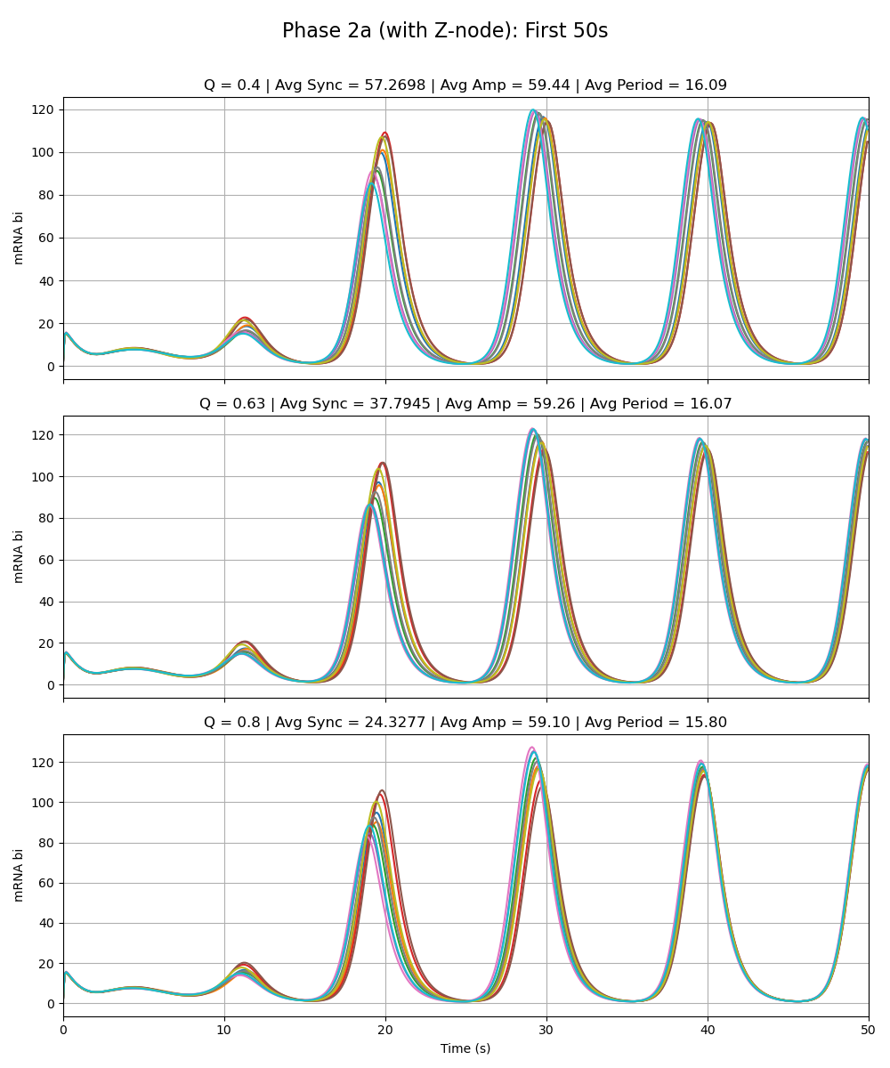
Weak Added Node
Notes:
Phase 2a – added link is very weak (max rate of z transcription is very low 0.01 vs. max rate for the rest as given by paper 216)

Slide 27
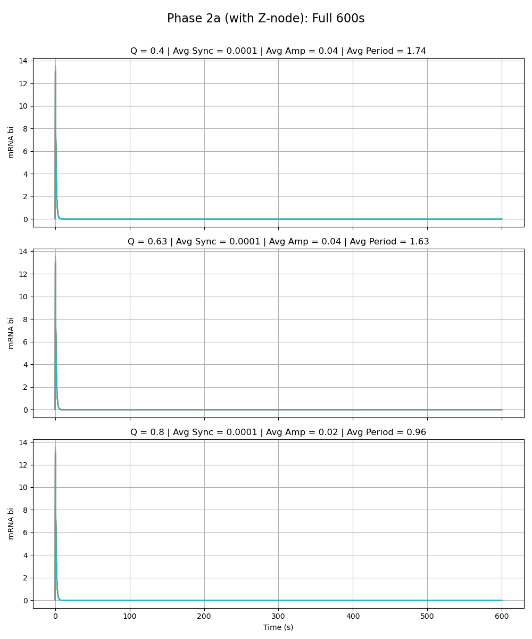
Equal Strength Added Node
Notes:
Phase 2a – added link is same strength as the rest of the circuit (max rate of z transcription is 216 vs. max rate for the rest as given by paper 216)

Slide 28
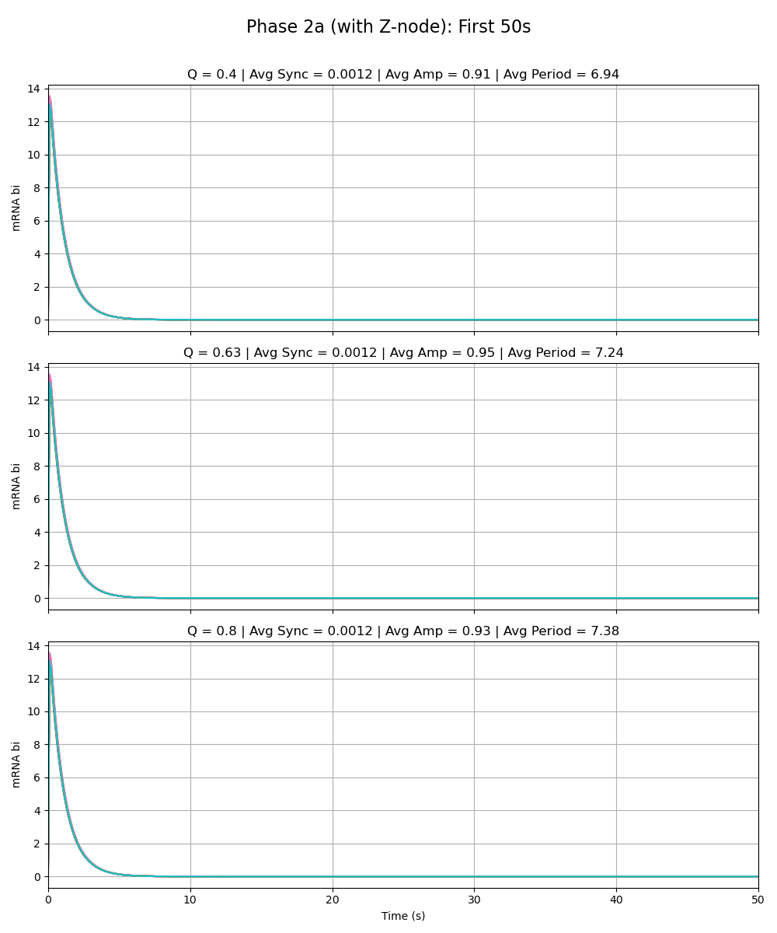
Equal Strength Added Node
Notes:
Phase 2a – added link is same strength as the rest of the circuit (max rate of z transcription is 216 vs. max rate for the rest as given by paper 216)

Slide 29
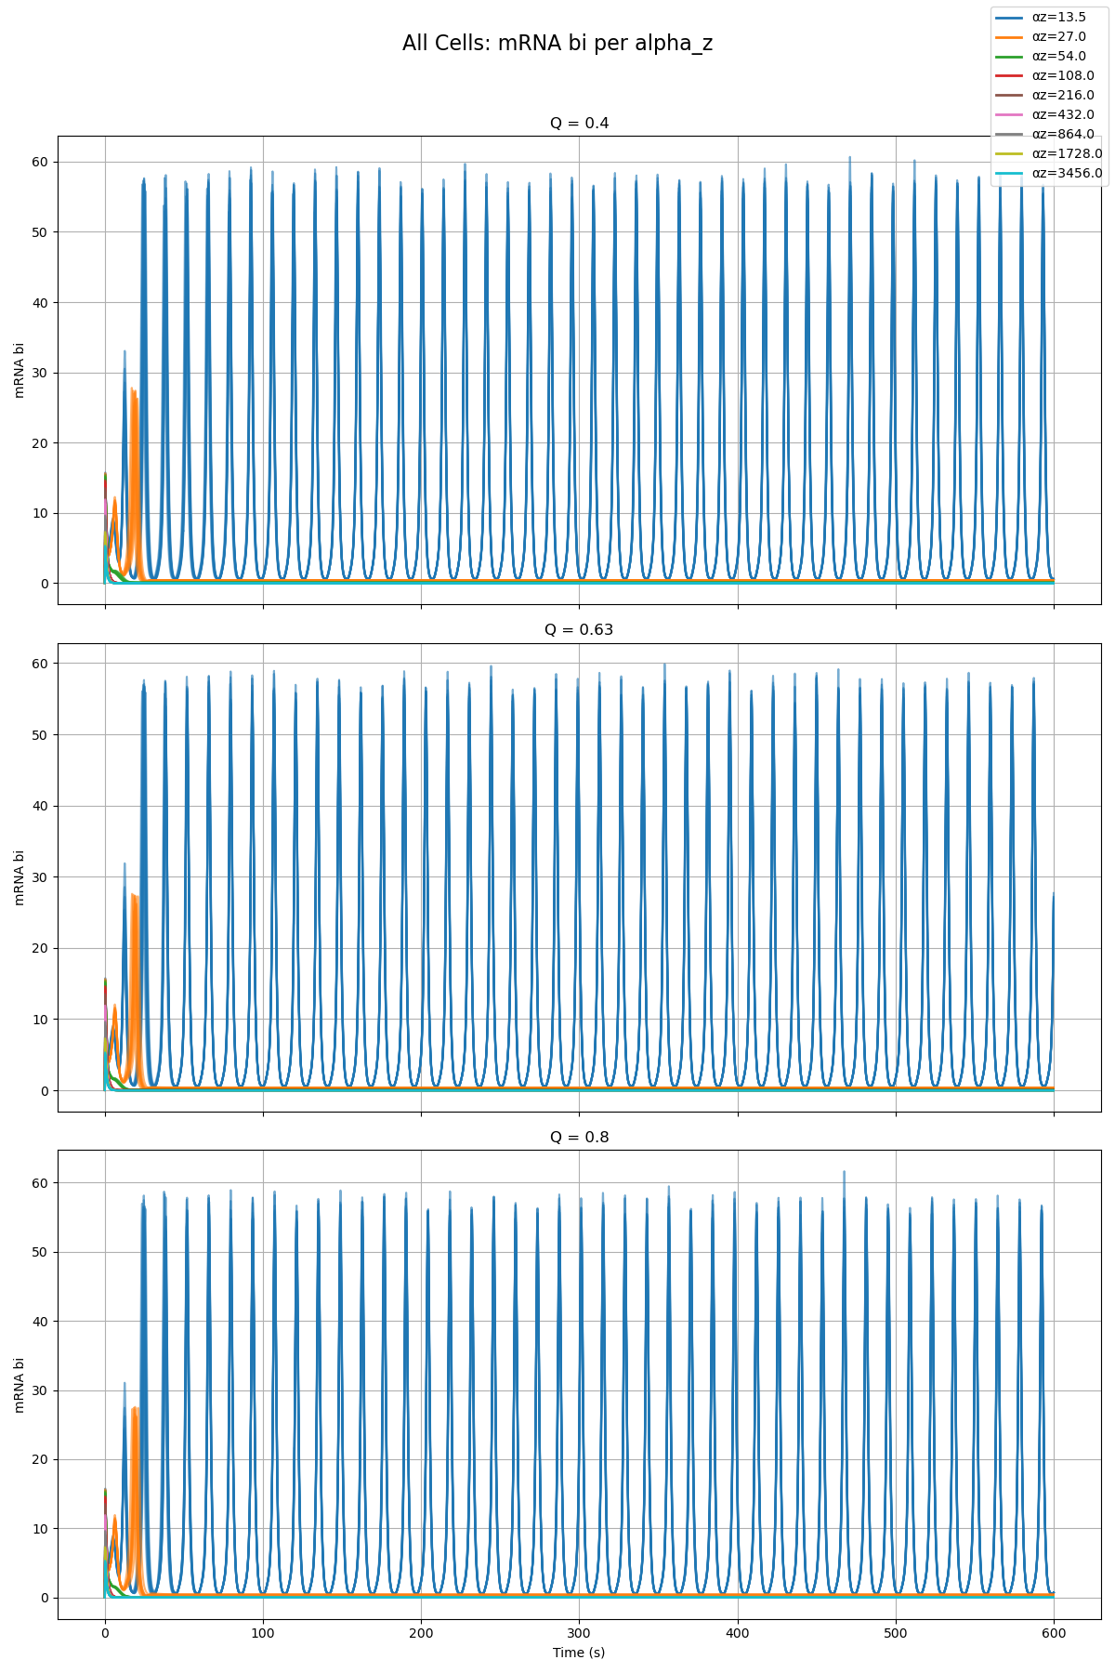
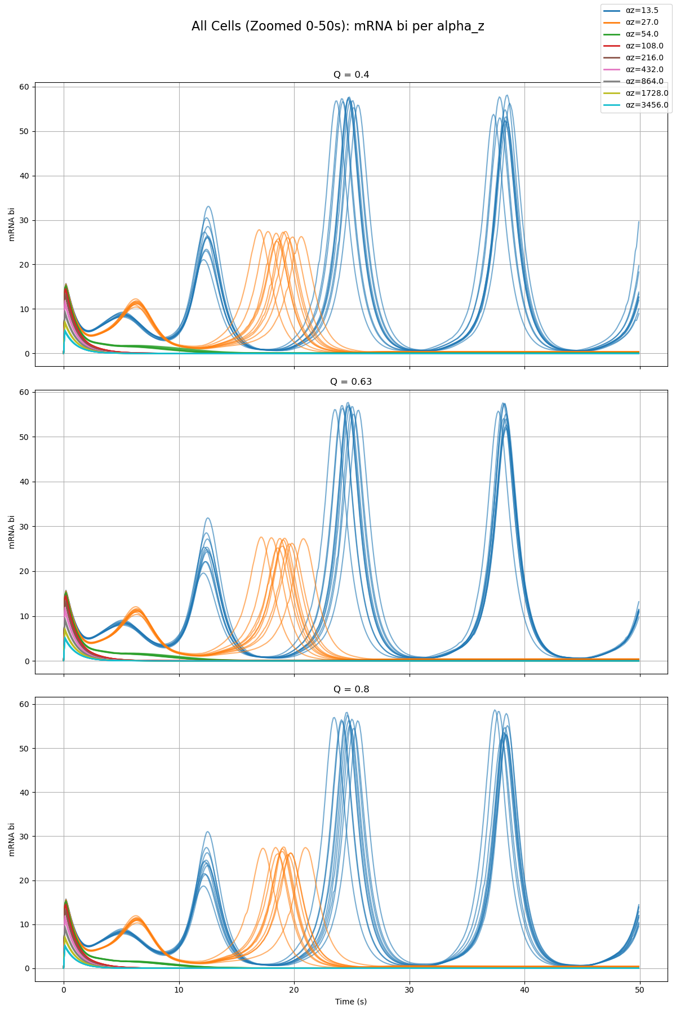
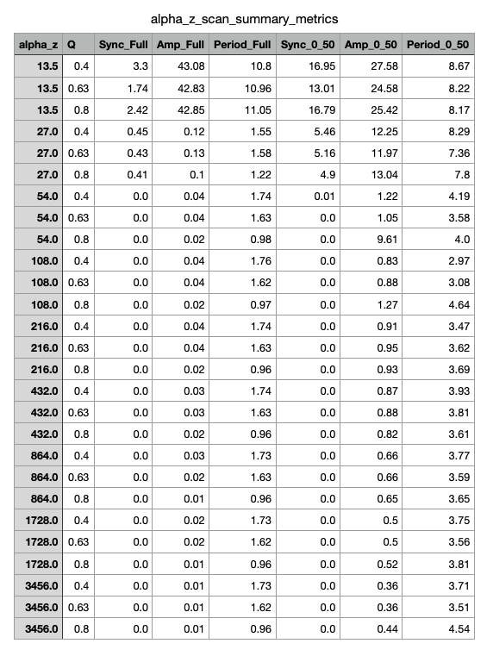
Parameter Scan

Slide 30
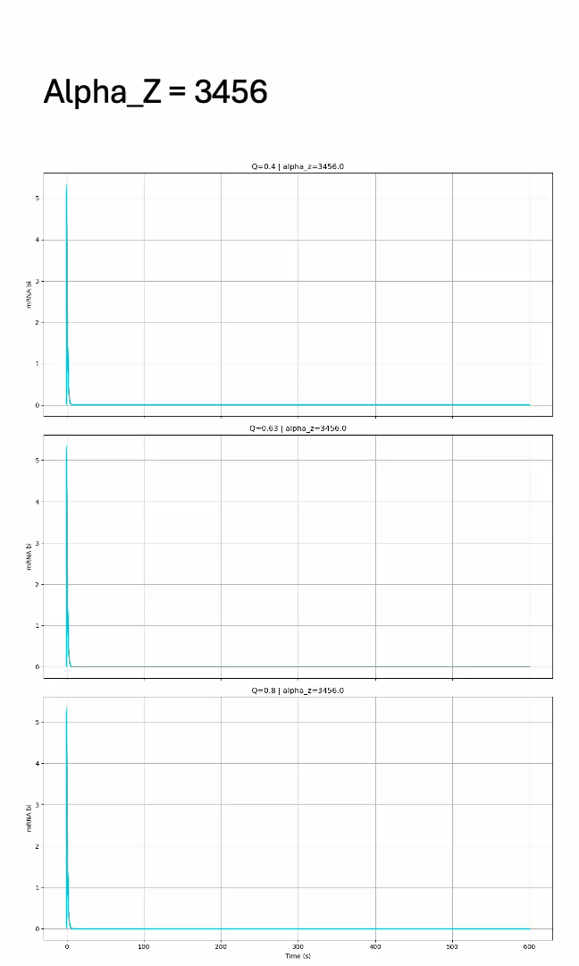
Parameter Scan

Slide 31
Phase 2b – Group Model

Slide 32
Paper Model vs. Group Model Alpha_W = 0.01 Alpha_X = 0.01 Alpha_Y = 0.01 Alpha_Z = 0.01

Slide 33
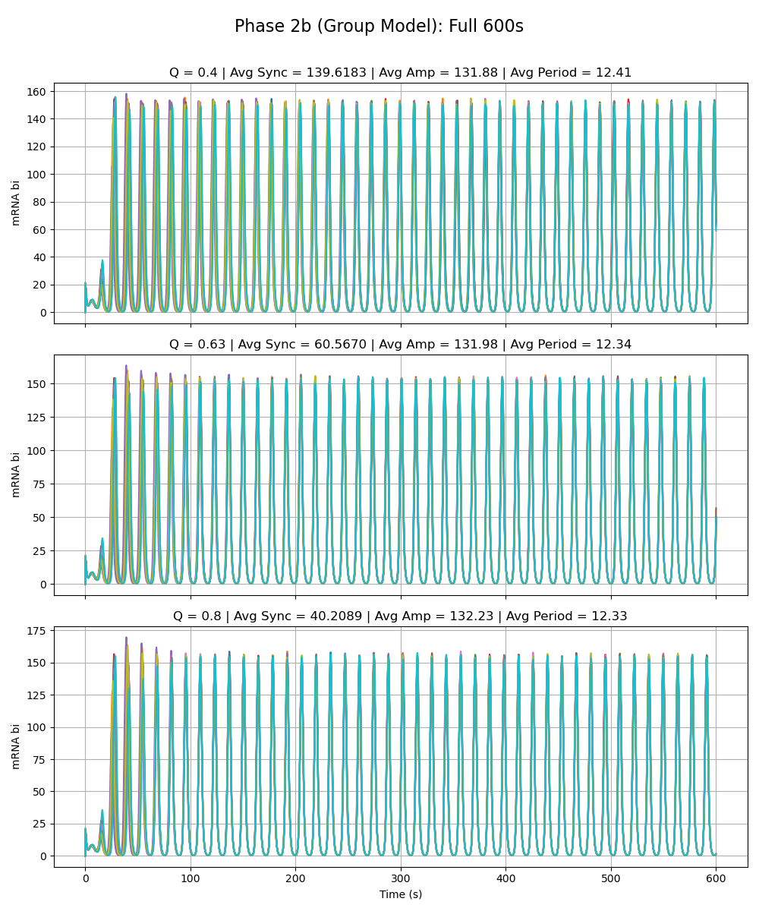
Notes:
All special alphas are 0.01

Slide 34
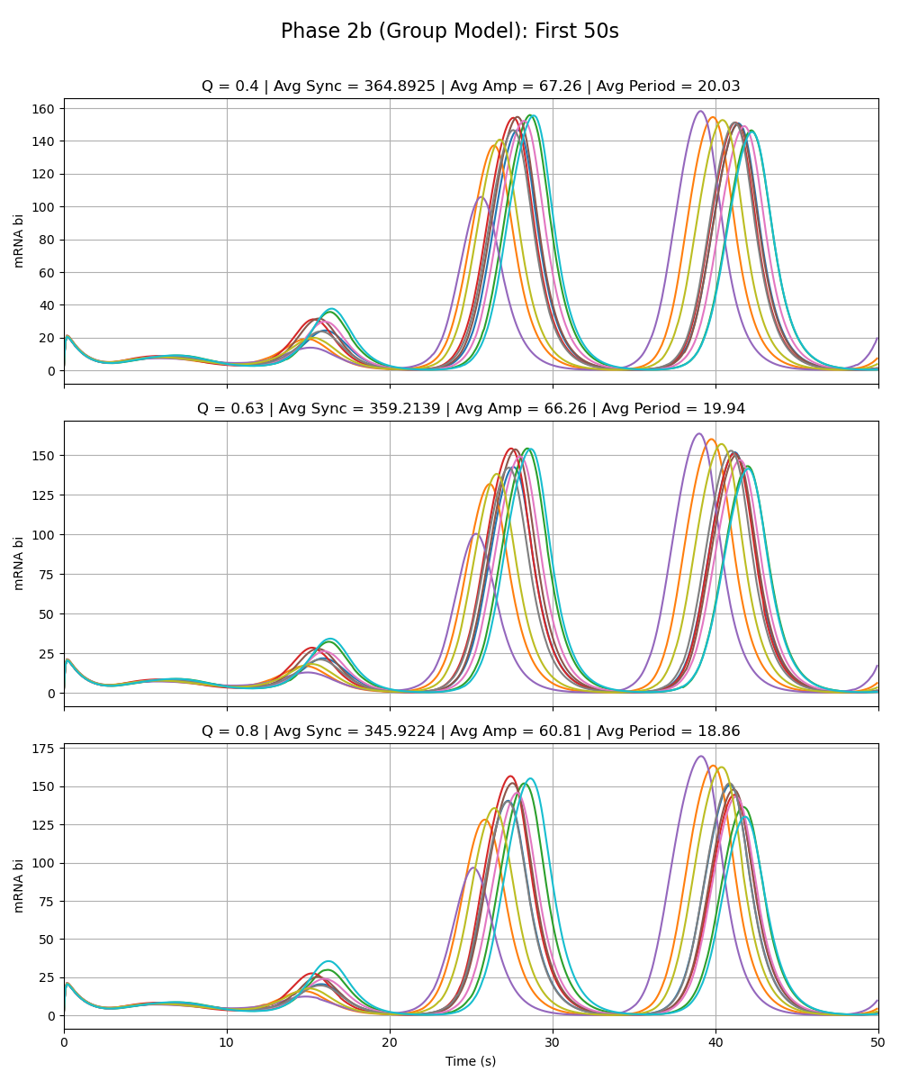
Notes:
All special alphas are 0.01

Slide 35
Adriana Phase 2a Model vs. Group Model Alpha_W = 216 Alpha_X = 0.01 Alpha_Y = 0.01 Alpha_Z = 0.01

Slide 36
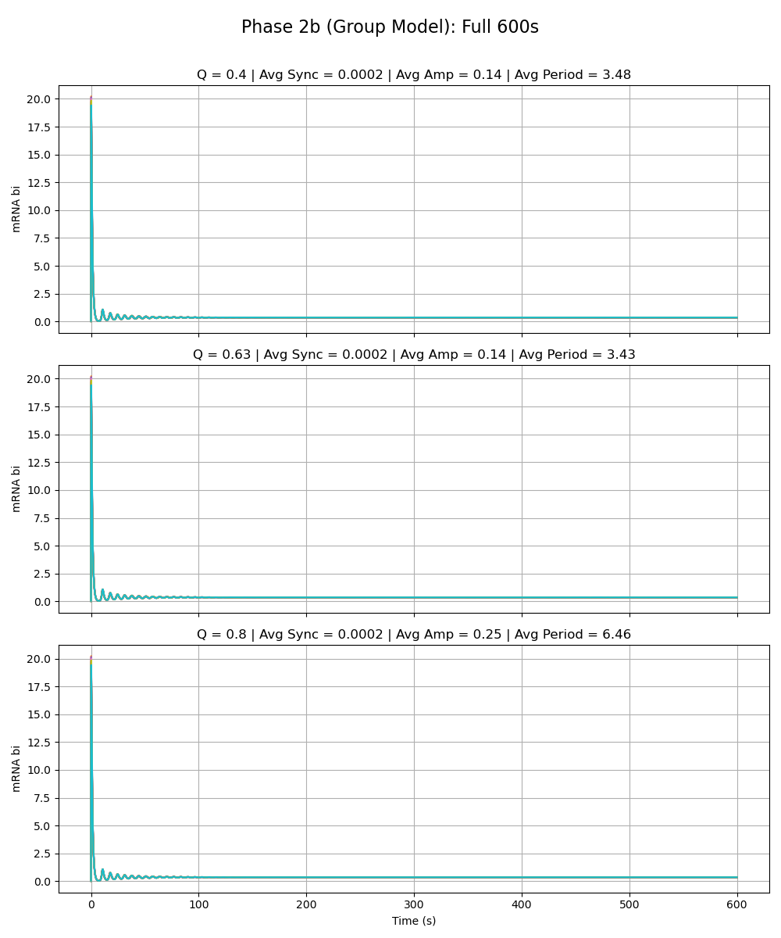
Notes:
alpha_w is 216

Slide 37
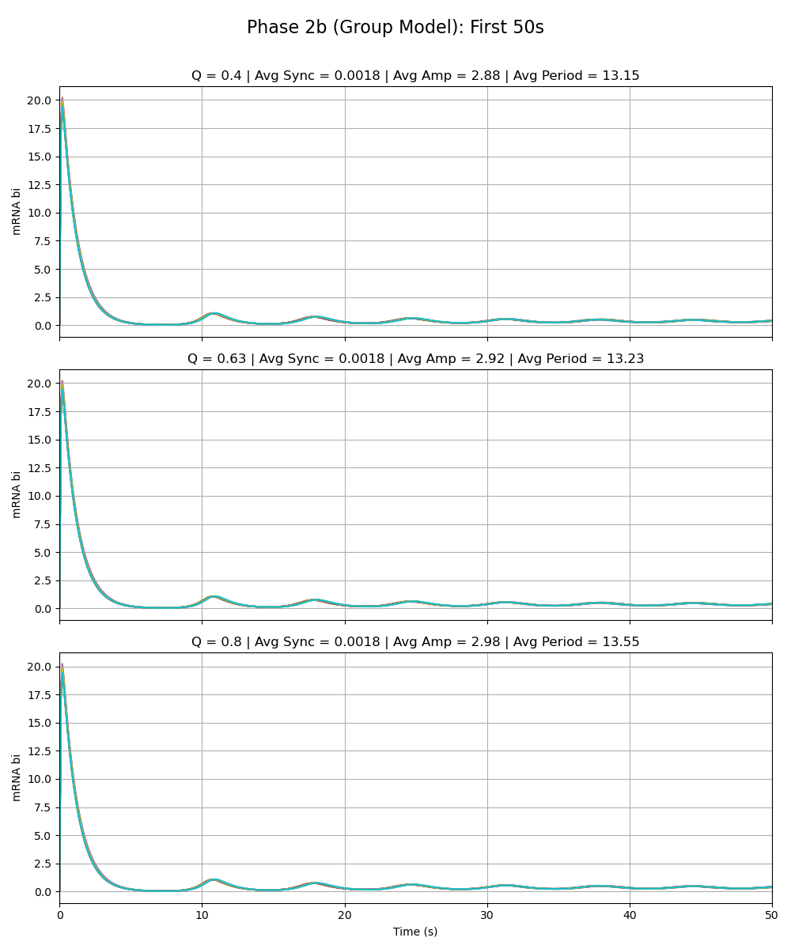
Notes:
alpha_w is 216

Slide 38
Sydney Phase 2a Model vs. Group Model Alpha_W = 0.01 Alpha_X = 216 Alpha_Y = 0.01 Alpha_Z = 0.01

Slide 39
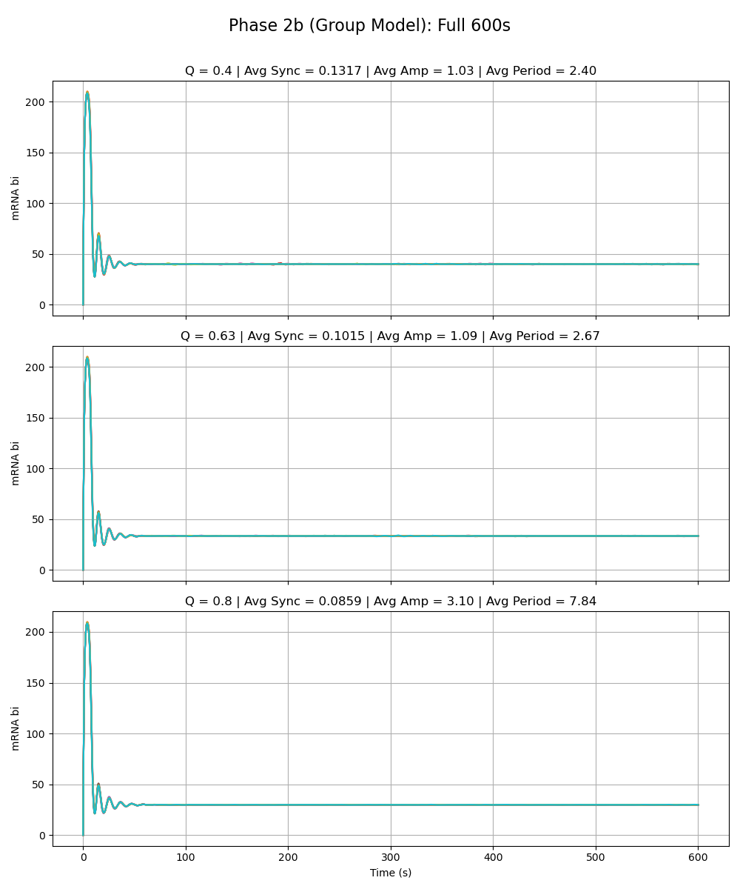
Notes:
alpha_x is 216

Slide 40
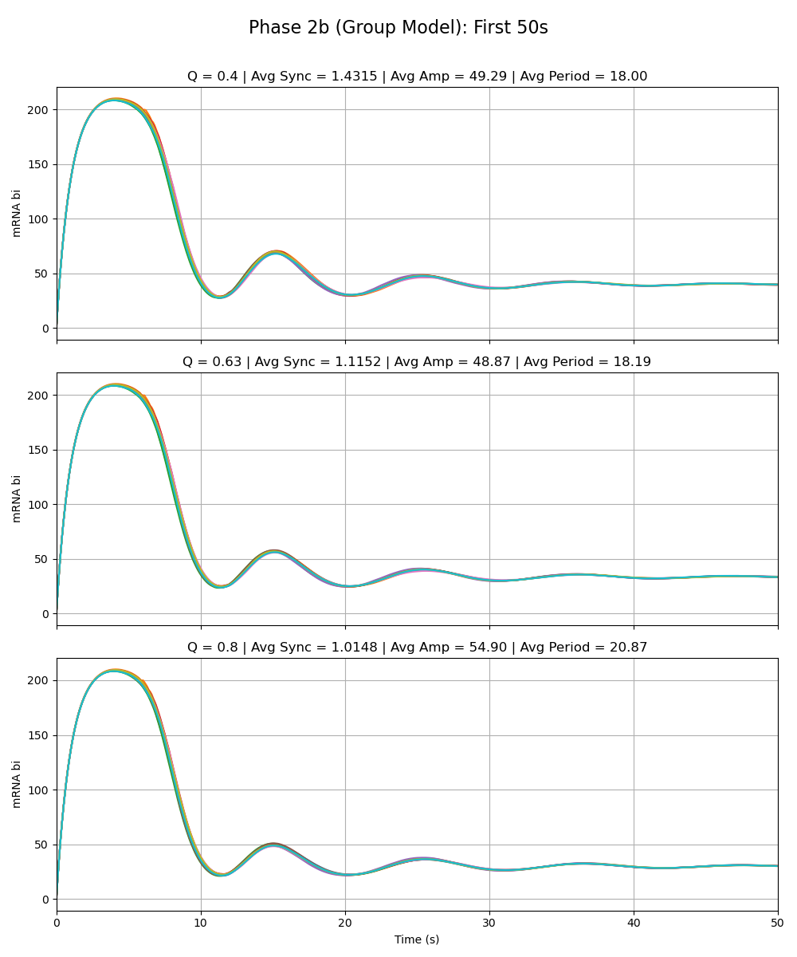
Notes:
alpha_x is 216

Slide 41
Sean Phase 2a Model vs. Group Model Alpha_W = 0.01 Alpha_X = 0.01 Alpha_Y = 216 Alpha_Z = 0.01

Slide 42
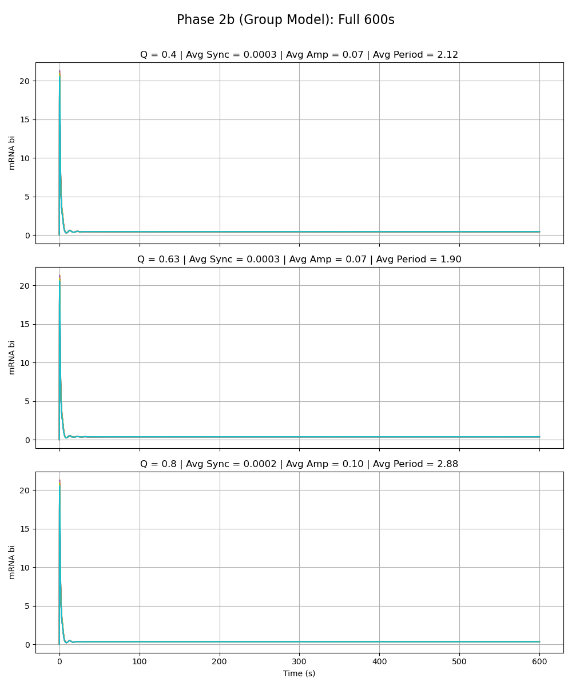
Notes:
alpha_y is 216

Slide 43
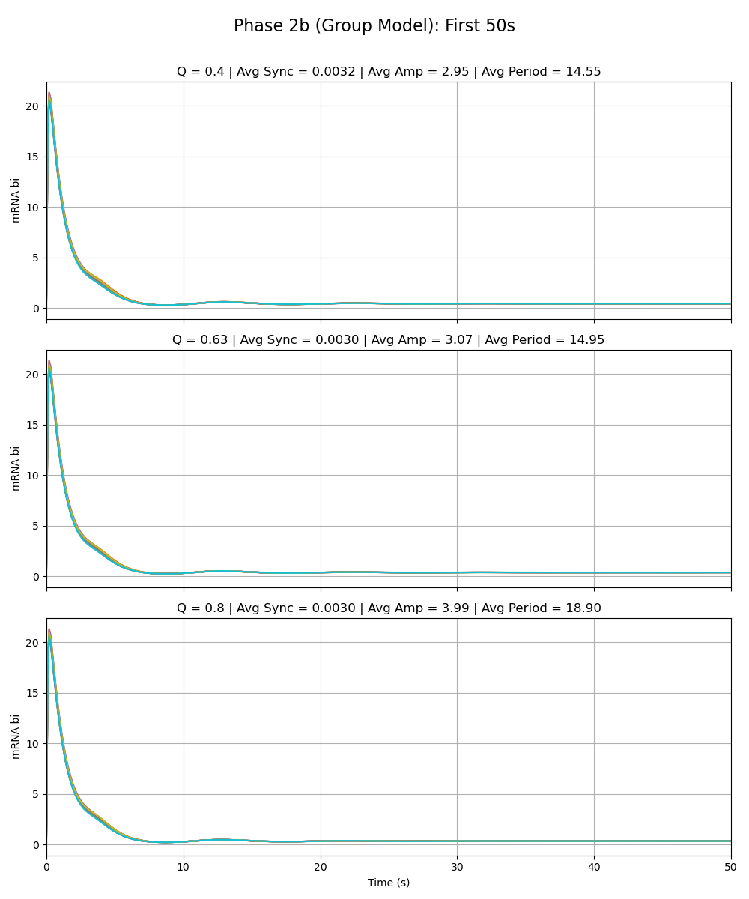
Notes:
alpha_y is 216

Slide 44
Olivia Phase 2a Model vs. Group Model Alpha_W = 0.01 Alpha_X = 0.01 Alpha_Y = 0.01 Alpha_Z = 216

Slide 45
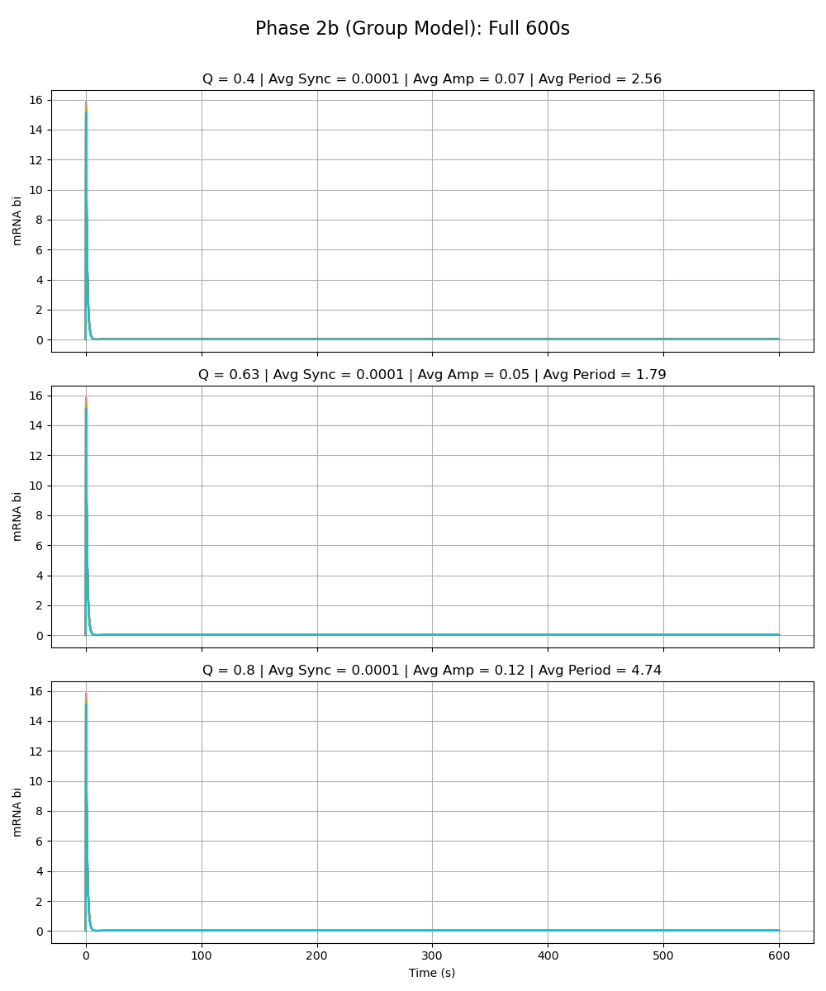
Notes:
alpha_z is 216

Slide 46
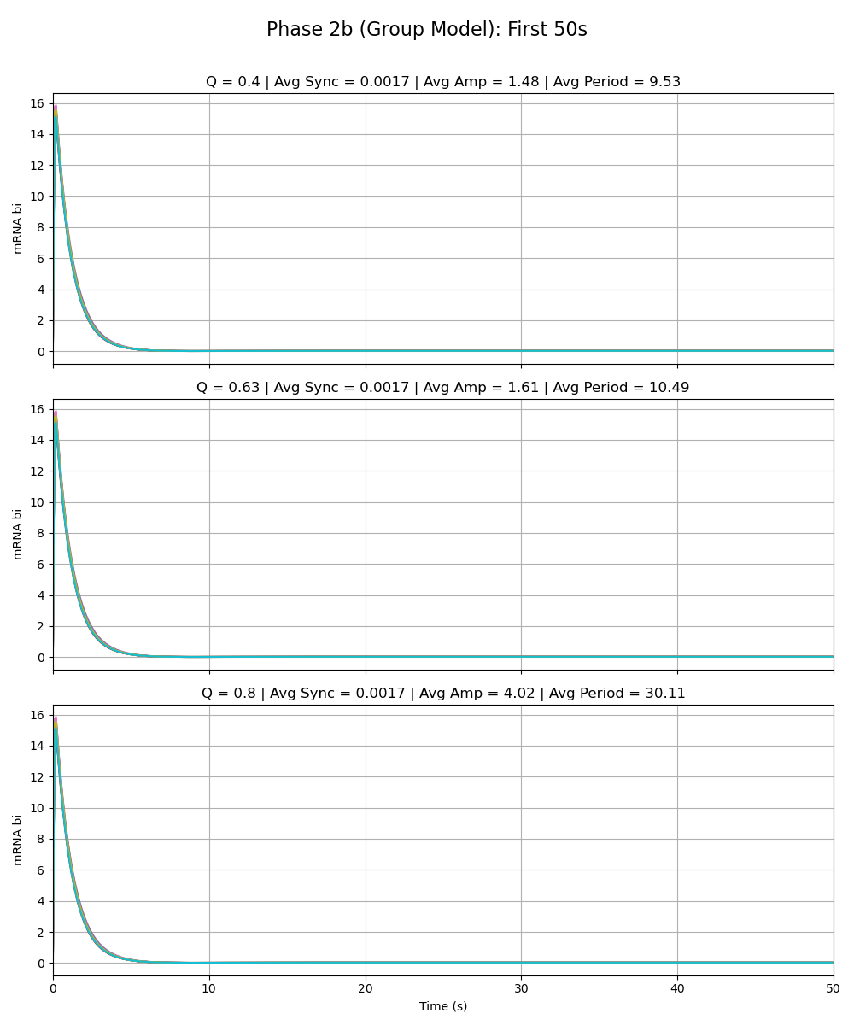
Notes:
alpha_z is 216

Slide 47
Phase 2b – Parameter Scan

Slide 48
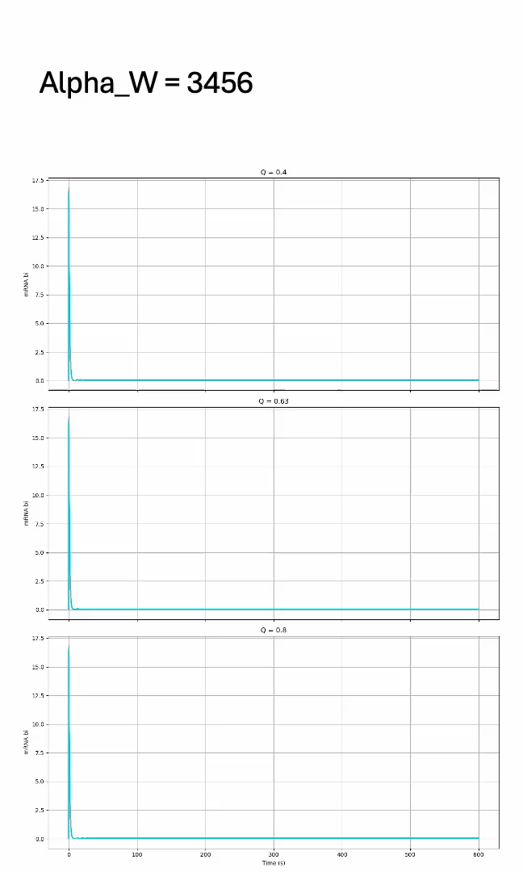
Parameter Scan: Alpha_W

Slide 49
Parameter Scan: Alpha_W
Q | Sync_Full | Amp_Full | Period_Full | Sync_0_50 | Amp_0_50 | Period_0_50 | Alpha_Value
0.4 | 0 | 0.69 | 5.24 | 0.02 | 6.38 | 6.55 | 13.5
0.4 | 0 | 0.42 | 4.75 | 0.01 | 4.75 | 6.27 | 27
0.4 | 0 | 0.29 | 4.65 | 0 | 3.63 | 5.99 | 54
0.4 | 0 | 0.19 | 4.04 | 0 | 3.22 | 6.31 | 108
0.4 | 0 | 0.14 | 3.48 | 0 | 2.88 | 6.57 | 216
0.4 | 0 | 0.11 | 3.2 | 0 | 2.67 | 6.81 | 432
0.4 | 0 | 0.09 | 2.95 | 0 | 2.36 | 6.6 | 864
0.4 | 0 | 0.08 | 2.69 | 0 | 2.63 | 7.39 | 1728
0.4 | 0 | 0.07 | 2.47 | 0 | 2.64 | 7.59 | 3456
0.63 | 0 | 0.71 | 5.42 | 0.02 | 6.23 | 6.38 | 13.5
0.63 | 0 | 0.44 | 5.07 | 0.01 | 4.92 | 6.48 | 27
0.63 | 0 | 0.28 | 4.54 | 0 | 3.56 | 5.84 | 54
0.63 | 0 | 0.19 | 4.06 | 0 | 3.08 | 6.06 | 108
0.63 | 0 | 0.14 | 3.43 | 0 | 2.92 | 6.62 | 216
0.63 | 0 | 0.11 | 3.19 | 0 | 2.57 | 6.51 | 432
0.63 | 0 | 0.09 | 2.9 | 0 | 2.4 | 6.77 | 864
0.63 | 0 | 0.08 | 2.66 | 0 | 2.71 | 7.5 | 1728
0.63 | 0 | 0.07 | 2.49 | 0 | 2.64 | 7.59 | 3456
0.8 | 0 | 0.82 | 6.44 | 0.02 | 6.12 | 6.28 | 13.5
0.8 | 0 | 0.55 | 6.34 | 0.01 | 4.78 | 6.3 | 27
0.8 | 0 | 0.39 | 6.34 | 0 | 3.79 | 6.24 | 54
0.8 | 0 | 0.3 | 6.4 | 0 | 3.16 | 6.24 | 108
0.8 | 0 | 0.25 | 6.46 | 0 | 2.98 | 6.77 | 216
0.8 | 0 | 0.2 | 5.87 | 0 | 2.52 | 6.37 | 432
0.8 | 0 | 0.15 | 4.86 | 0 | 2.38 | 6.67 | 864
0.8 | 0 | 0.12 | 4.25 | 0 | 2.71 | 7.51 | 1728
0.8 | 0 | 0.1 | 3.54 | 0 | 2.76 | 7.92 | 3456

Slide 50
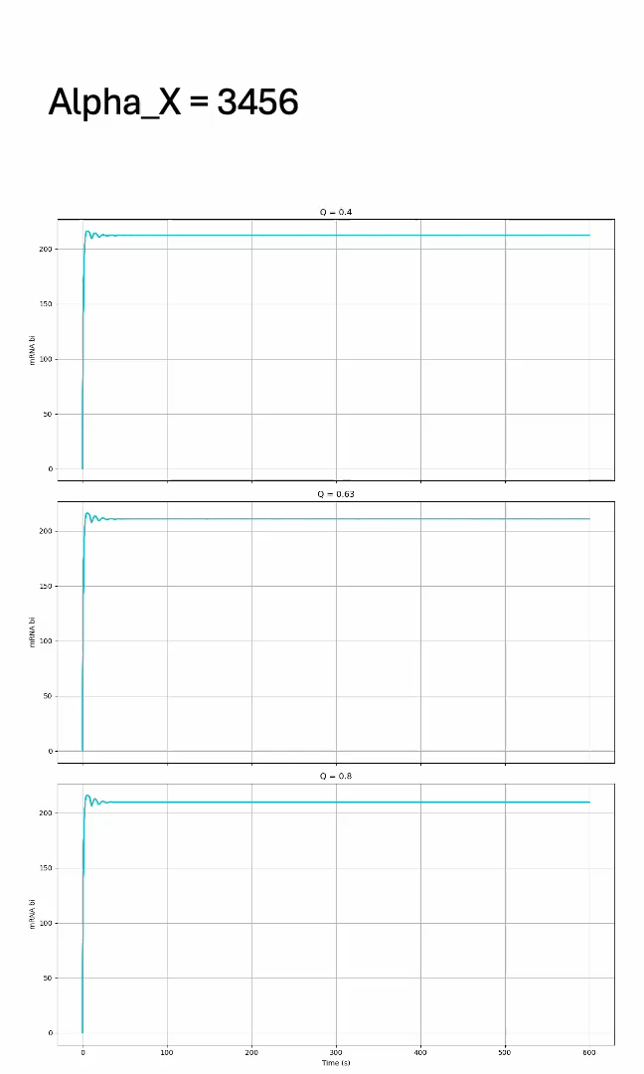
Parameter Scan: Alpha_X

Slide 51
Parameter Scan: Alpha_X
Q | Sync_Full | Amp_Full | Period_Full | Sync_0_50 | Amp_0_50 | Period_0_50 | Alpha_Value
0.4 | 1727.13 | 173.28 | 14.41 | 26.45 | 157.28 | 14.62 | 13.5
0.4 | 306.99 | 145.74 | 13.93 | 58.92 | 133.48 | 14.19 | 27
0.4 | 437.73 | 108.28 | 13.02 | 25.46 | 127.39 | 13.81 | 54
0.4 | 4.8 | 47.08 | 11.91 | 2.67 | 69.05 | 12.23 | 108
0.4 | 0.13 | 1.03 | 2.4 | 1.43 | 49.29 | 9 | 216
0.4 | 0.16 | 0.95 | 2.29 | 1.57 | 34.23 | 7.51 | 432
0.4 | 0.09 | 0.55 | 2.24 | 0.79 | 18.88 | 7.2 | 864
0.4 | 0.02 | 0.2 | 2.27 | 0.2 | 6.94 | 7.35 | 1728
0.4 | 0 | 0.05 | 2.23 | 0.02 | 1.39 | 5.45 | 3456
0.63 | 6810.81 | 236.25 | 16.19 | 54.53 | 176.08 | 15.38 | 13.5
0.63 | 5001.39 | 194.18 | 15.21 | 33.52 | 151.26 | 14.46 | 27
0.63 | 1186.49 | 128.39 | 13.9 | 32.67 | 133.44 | 14.11 | 54
0.63 | 6.41 | 62.85 | 12.11 | 5.36 | 76.14 | 12.2 | 108
0.63 | 0.1 | 1.09 | 2.67 | 1.12 | 48.87 | 9.1 | 216
0.63 | 0.14 | 0.96 | 2.37 | 1.31 | 34.43 | 7.43 | 432
0.63 | 0.08 | 0.63 | 2.38 | 0.73 | 22.01 | 7.58 | 864
0.63 | 0.02 | 0.24 | 2.36 | 0.2 | 8.66 | 7.7 | 1728
0.63 | 0 | 0.06 | 2.31 | 0.02 | 2.28 | 7.05 | 3456
0.8 | 9208.19 | 270.83 | 16.81 | 55.71 | 188.75 | 15.95 | 13.5
0.8 | 7802.32 | 238.49 | 16.48 | 37.54 | 166.75 | 15.29 | 27
0.8 | 617.05 | 130.65 | 13.91 | 27.63 | 137.74 | 14.28 | 54
0.8 | 11.28 | 71.97 | 12.26 | 14.93 | 85.98 | 12.75 | 108
0.8 | 0.09 | 3.1 | 7.84 | 1.01 | 54.9 | 10.44 | 216
0.8 | 0.1 | 2.76 | 7.19 | 1.18 | 43.07 | 9.28 | 432
0.8 | 0.07 | 1.8 | 6.94 | 0.73 | 27.55 | 8.54 | 864
0.8 | 0.02 | 0.67 | 6.42 | 0.19 | 10.94 | 8.43 | 1728
0.8 | 0 | 0.19 | 6.51 | 0.02 | 2.97 | 7.95 | 3456

Slide 52
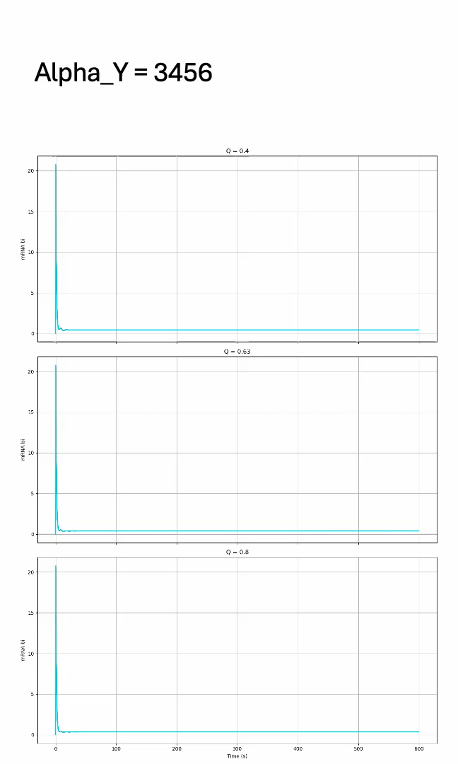
Parameter Scan: Alpha_Y

Slide 53
Parameter Scan: Alpha_Y
Q | Sync_Full | Amp_Full | Period_Full | Sync_0_50 | Amp_0_50 | Period_0_50 | Alpha_Value
0.4 | 36.65 | 34.04 | 9.69 | 50.78 | 17.46 | 8.46 | 13.5
0.4 | 0.02 | 0.11 | 2.13 | 0.22 | 4.14 | 6.62 | 27
0.4 | 0 | 0.07 | 2.1 | 0.01 | 3.29 | 7.71 | 54
0.4 | 0 | 0.07 | 2.1 | 0 | 2.23 | 5.69 | 108
0.4 | 0 | 0.07 | 2.12 | 0 | 2.95 | 7.27 | 216
0.4 | 0 | 0.07 | 2.07 | 0 | 3.29 | 8.04 | 432
0.4 | 0 | 0.07 | 2.16 | 0 | 2.64 | 6.61 | 864
0.4 | 0 | 0.07 | 2.07 | 0 | 1.79 | 4.36 | 1728
0.4 | 0 | 0.07 | 2.05 | 0 | 2.16 | 5.24 | 3456
0.63 | 47.8 | 32.04 | 9.6 | 52.57 | 16.97 | 8.72 | 13.5
0.63 | 0.01 | 0.1 | 1.97 | 0.1 | 4.04 | 6.77 | 27
0.63 | 0 | 0.07 | 1.92 | 0 | 3.78 | 8.63 | 54
0.63 | 0 | 0.07 | 1.88 | 0 | 2.13 | 5.19 | 108
0.63 | 0 | 0.07 | 1.9 | 0 | 3.07 | 7.47 | 216
0.63 | 0 | 0.07 | 1.95 | 0 | 2.89 | 6.98 | 432
0.63 | 0 | 0.07 | 1.91 | 0 | 2.49 | 6.13 | 864
0.63 | 0 | 0.06 | 1.84 | 0 | 1.62 | 4.04 | 1728
0.63 | 0 | 0.06 | 1.92 | 0 | 2.12 | 5.39 | 3456
0.8 | 18.52 | 31.26 | 9.68 | 50.62 | 16.64 | 8.78 | 13.5
0.8 | 0 | 0.12 | 2.52 | 0.06 | 3.88 | 6.71 | 27
0.8 | 0 | 0.08 | 2.39 | 0 | 4.77 | 10.86 | 54
0.8 | 0 | 0.09 | 2.68 | 0 | 3.56 | 8.53 | 108
0.8 | 0 | 0.1 | 2.88 | 0 | 3.99 | 9.45 | 216
0.8 | 0 | 0.09 | 2.5 | 0 | 3.95 | 9.43 | 432
0.8 | 0 | 0.09 | 2.54 | 0 | 3.65 | 8.78 | 864
0.8 | 0 | 0.09 | 2.61 | 0 | 3.31 | 7.78 | 1728
0.8 | 0 | 0.09 | 2.63 | 0 | 3.16 | 8.02 | 3456

Slide 54
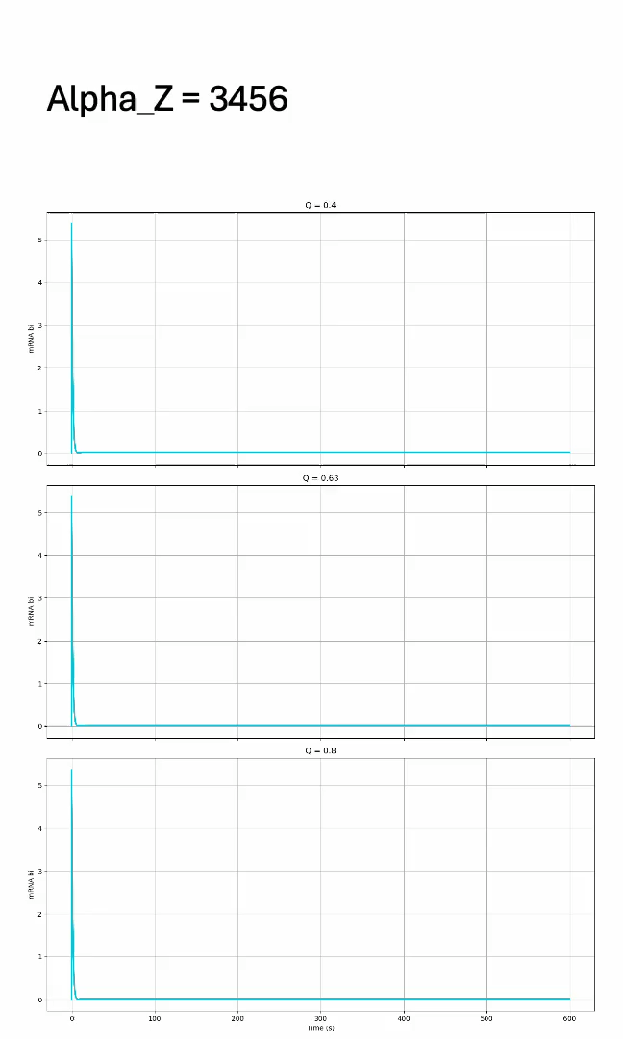
Parameter Scan: Alpha_Z

Slide 55
Parameter Scan: Alpha_Z
Q | Sync_Full | Amp_Full | Period_Full | Sync_0_50 | Amp_0_50 | Period_0_50 | Alpha_Value
0.4 | 27.71 | 81.46 | 15.13 | 96.07 | 44.83 | 11.54 | 13.5
0.4 | 0.02 | 0.13 | 2.4 | 0.23 | 5.62 | 8.88 | 27
0.4 | 0 | 0.08 | 2.55 | 0 | 1.88 | 4.82 | 54
0.4 | 0 | 0.08 | 2.55 | 0 | 1.59 | 4.41 | 108
0.4 | 0 | 0.07 | 2.56 | 0 | 1.48 | 4.77 | 216
0.4 | 0 | 0.05 | 2.52 | 0 | 1.07 | 4.16 | 432
0.4 | 0 | 0.04 | 2.55 | 0 | 0.87 | 4.43 | 864
0.4 | 0 | 0.03 | 2.54 | 0 | 0.63 | 4.33 | 1728
0.4 | 0 | 0.02 | 2.54 | 0 | 0.45 | 4.41 | 3456
0.63 | 11.11 | 77.75 | 14.72 | 80.96 | 38.18 | 10.59 | 13.5
0.63 | 0.02 | 0.13 | 2.32 | 0.21 | 10.43 | 10.54 | 27
0.63 | 0 | 0.06 | 1.81 | 0 | 13.96 | 28.24 | 54
0.63 | 0 | 0.05 | 1.77 | 0 | 1.9 | 5.53 | 108
0.63 | 0 | 0.05 | 1.79 | 0 | 1.61 | 5.25 | 216
0.63 | 0 | 0.04 | 1.79 | 0 | 1.36 | 5.34 | 432
0.63 | 0 | 0.03 | 1.8 | 0 | 1.11 | 5.8 | 864
0.63 | 0 | 0.02 | 1.79 | 0 | 0.77 | 5.36 | 1728
0.63 | 0 | 0.02 | 1.8 | 0 | 0.52 | 5.17 | 3456
0.8 | 7.52 | 79.6 | 15.18 | 62.03 | 43.18 | 11.4 | 13.5
0.8 | 0.02 | 0.14 | 2.61 | 0.2 | 15.04 | 8.93 | 27
0.8 | 0 | 0.07 | 2.03 | 0 | 0 | 0 | 54
0.8 | 0 | 0.09 | 2.9 | 0 | 5.14 | 18.23 | 108
0.8 | 0 | 0.12 | 4.74 | 0 | 4.02 | 15.06 | 216
0.8 | 0 | 0.13 | 6.05 | 0 | 4.62 | 19.67 | 432
0.8 | 0 | 0.11 | 6.37 | 0 | 4.38 | 24.18 | 864
0.8 | 0 | 0.08 | 6.29 | 0 | 2.51 | 18.22 | 1728
0.8 | 0 | 0.05 | 6.25 | 0 | 2.54 | 22.79 | 3456

